Slide 1
Big Deficit World
Joseph Wang
October 2024

Slide 2
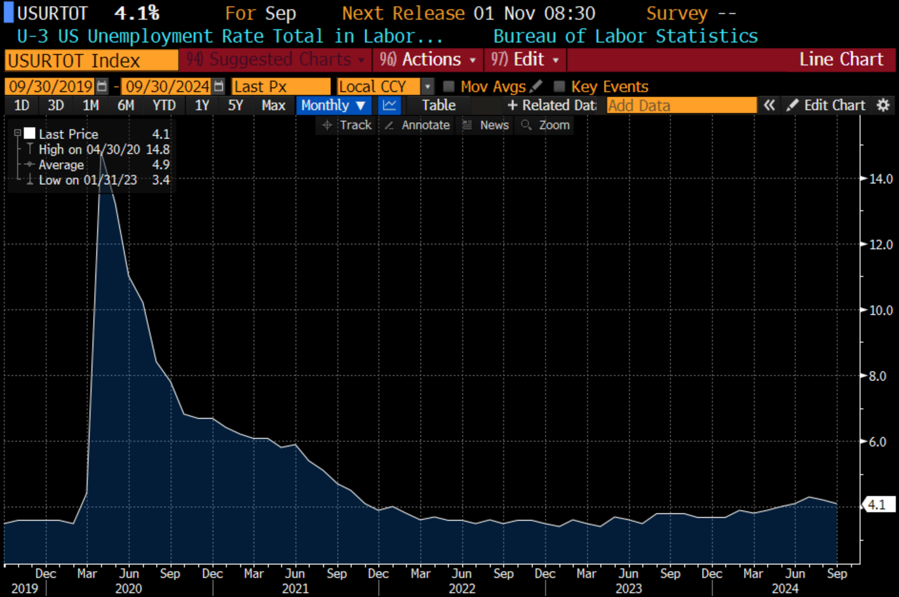
Fed Is Becoming Employment Focused

Slide 3
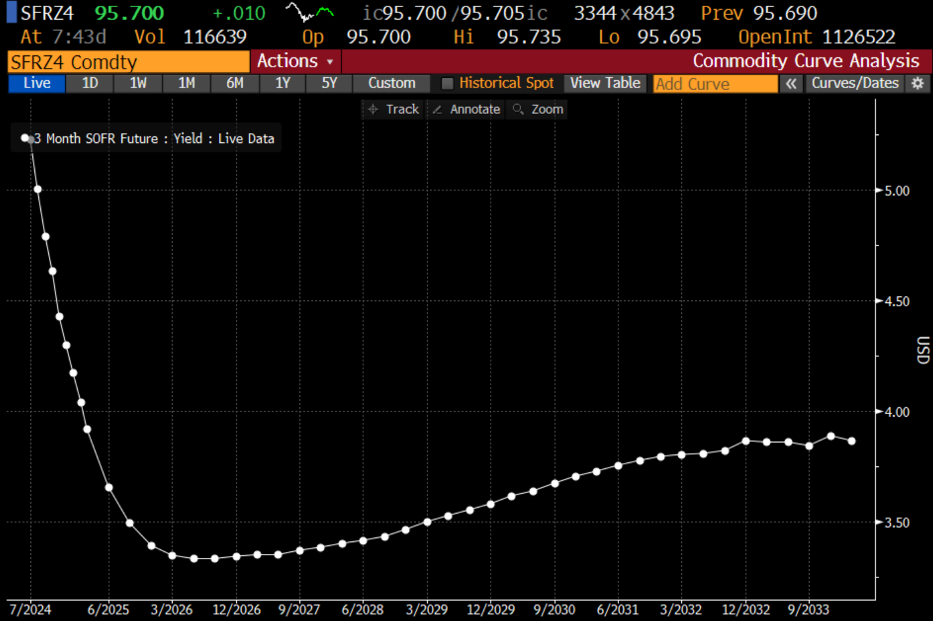
But Unlikely to Return to Zero

Slide 4
QT Proceeding Steadily
QT has been slow since the taper in May. Monthly roll-off is now roughly $45b a month ($25b Treasuries and ~$15b in Agency MBS.
Fed is moving towards an all Treasury portfolio.
Some Fed officials have suggested the final portfolio could be a bill heavy portfolio. That would increase flexibility and more closely match interest expense. It would also imply more duration for the private sector.

Slide 5
No Reserve Constraints (So Far)
Most measures suggest abundant reserves:
No relationship between reserve levels and Fed funds rate.
Banks are not delaying interbank payments.
No up-tick in daylight overdrafts.
Domestic banks are not notably active in federal funds market.
BUT, more repo volumes are conducted above IOR.
Source: Roberto Perli of FRBNY speech on September 26, 2024.

Slide 6
Quarter-End Repo Spikes Are Normal

Slide 7
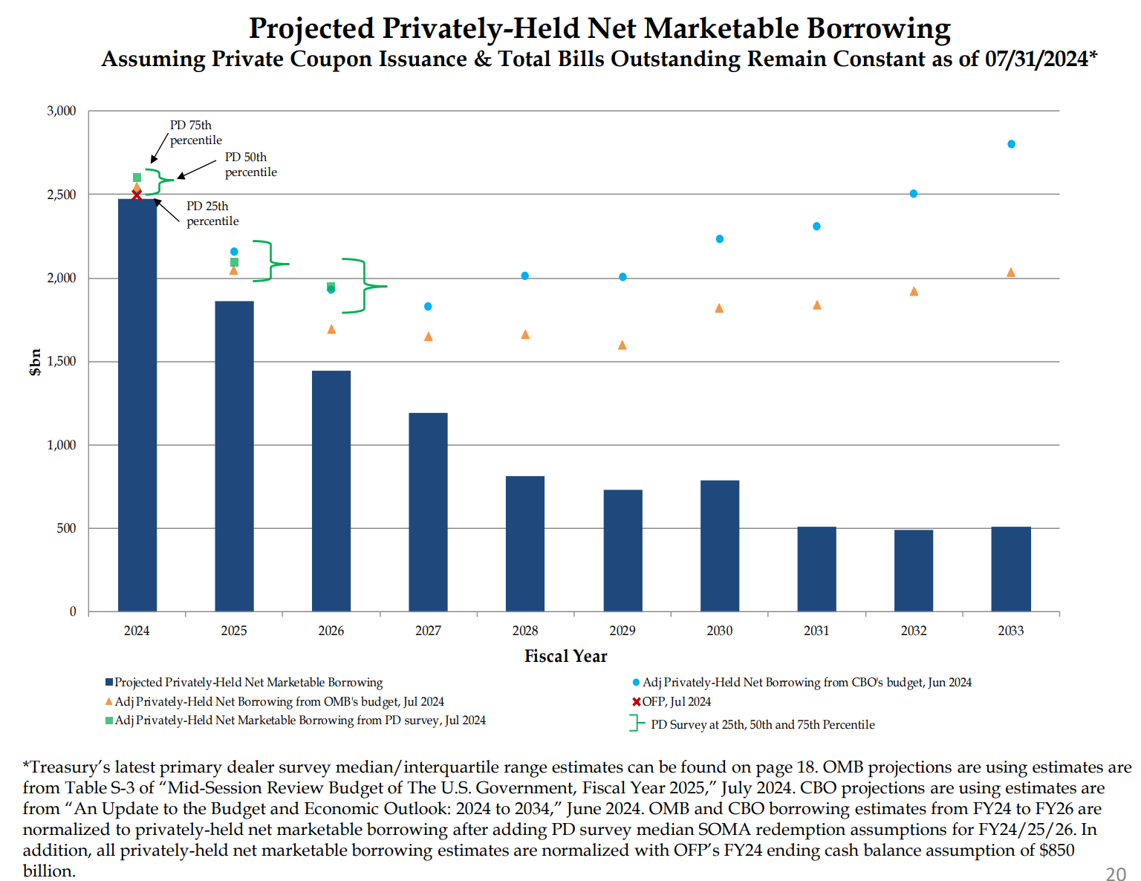
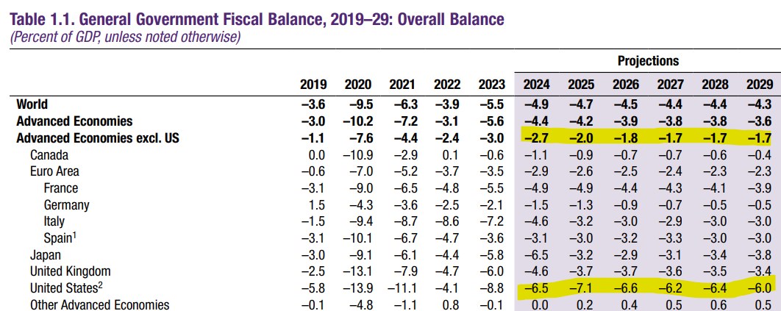
Treasury Supply Estimated To Be Huge
Treasury issuance is expected by around 6% of GDP for the foreseeable future.
Source: U.S. Treasury TBAC 2024 Q3 Presentation. IMF Fiscal Report, April 2024.

Slide 8
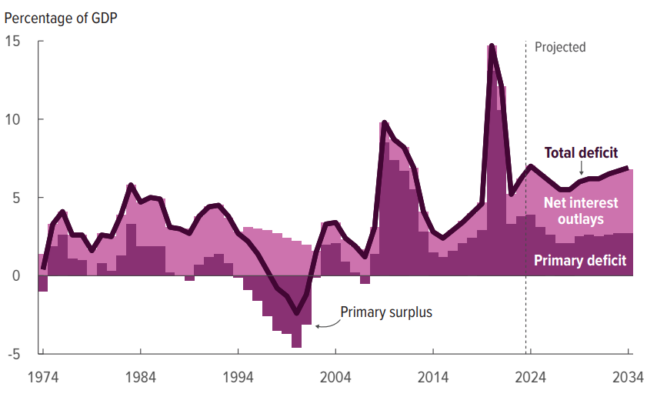
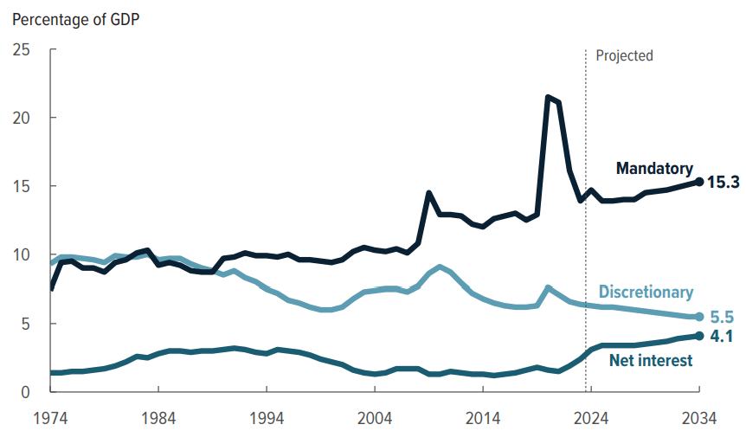
Deficit Is Structural
Fiscal deficit based on current law is expected to be structurally 6+% of GDP a year forever. That is likely an underestimation.
Source: “An Update to the Budget and Economic Outlook: 2024 to 2034.” Congressional Budget Office.

Slide 9
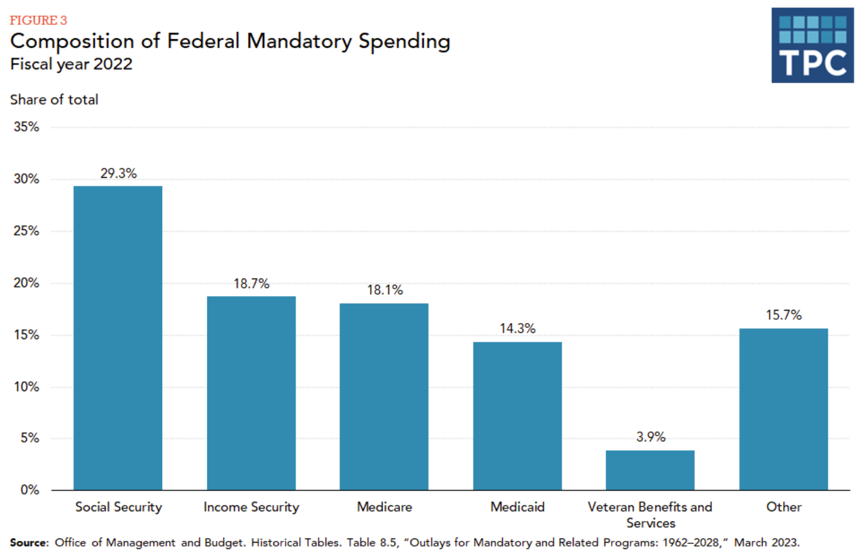
Mandatory Outlays
Mandatory spending is very difficult to change, and discretionary military spending looks to rise.
Source: Tax Policy Center
Source: Council of Foreign Relations

Slide 10
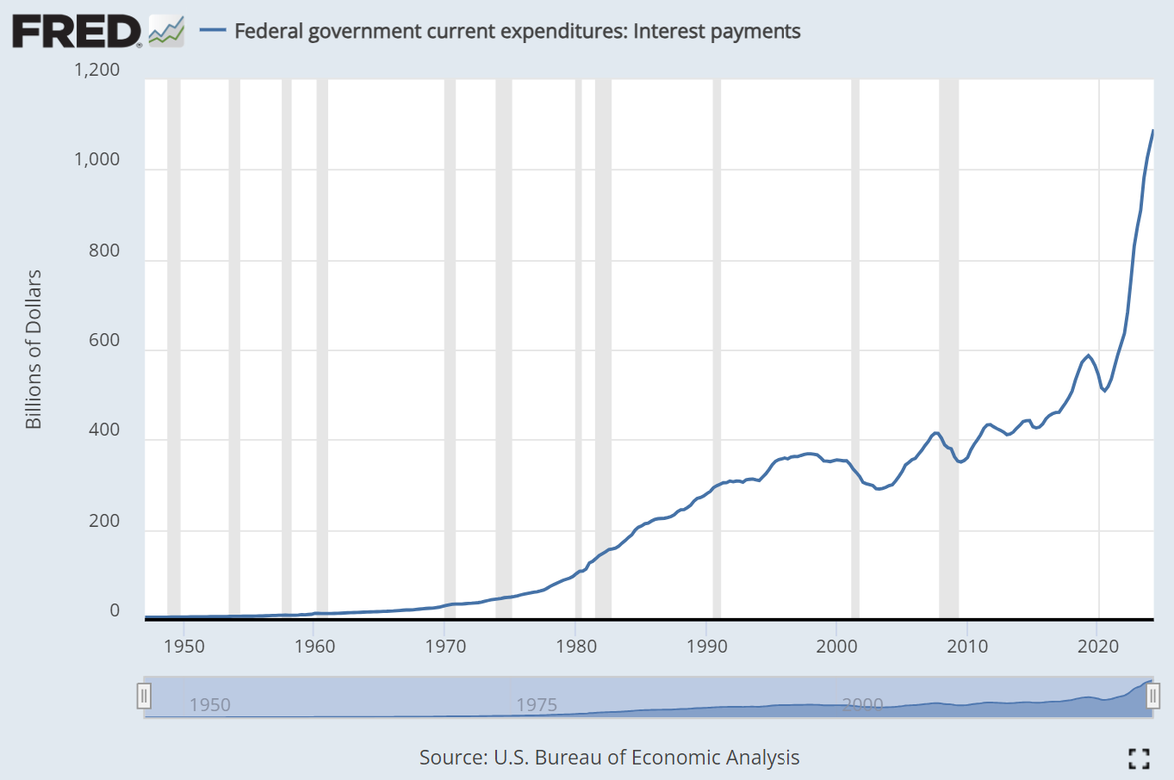
Interest Expenditures
Markets anticipates structurally higher rates where the rate cut cycle ends around 3%. Interest expense could stay high.

Slide 11
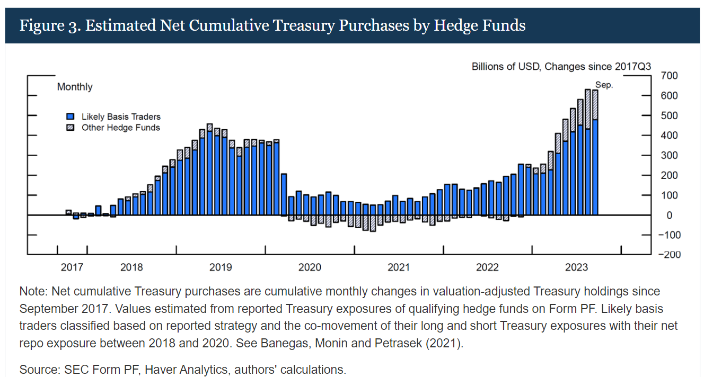
Finding Balance Sheet
Treasury market has grown much faster than intermediation capacity. Hedge funds the a significant marginal buyer.
Source: Glicoes et al. “Quantifying Treasury Cash-Futures Basis Trades.” FEDS Note.

Slide 12
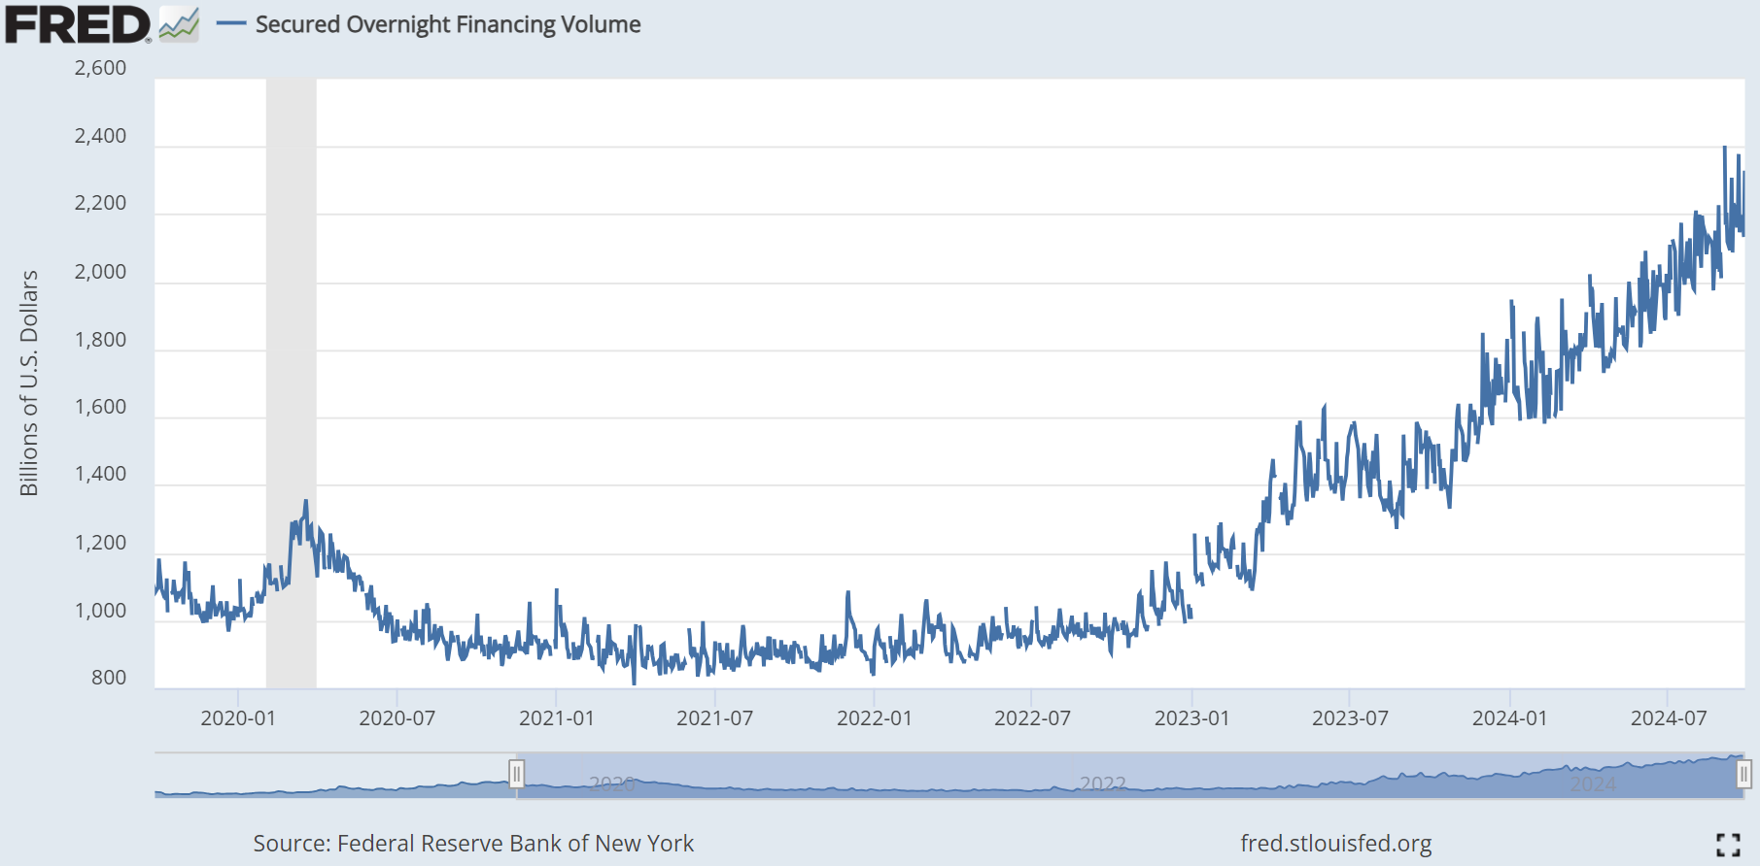
Cash-Futures Basis Trade
Asset Managers increasing duration via futures. This widens the basis and draws in hedge fund relative values traders.
Source: Barth, Kahn et al. “Reaching for Duration and Leverage in the Treasury Market.” Federal Reserve.

Slide 13
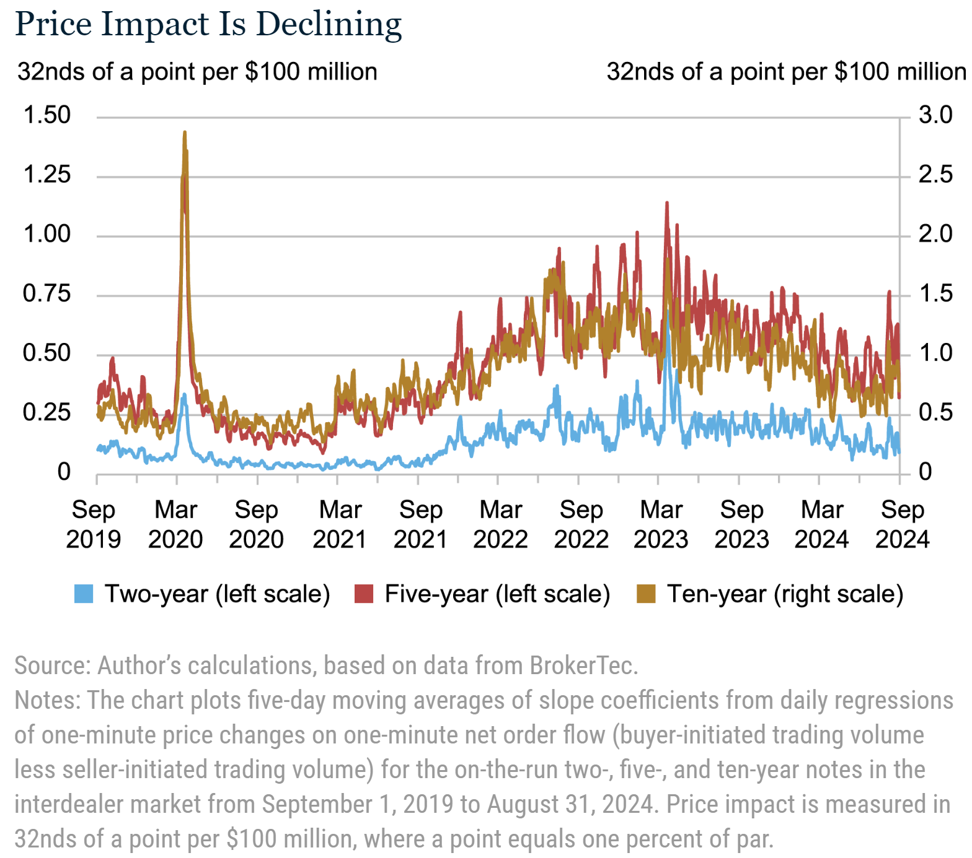
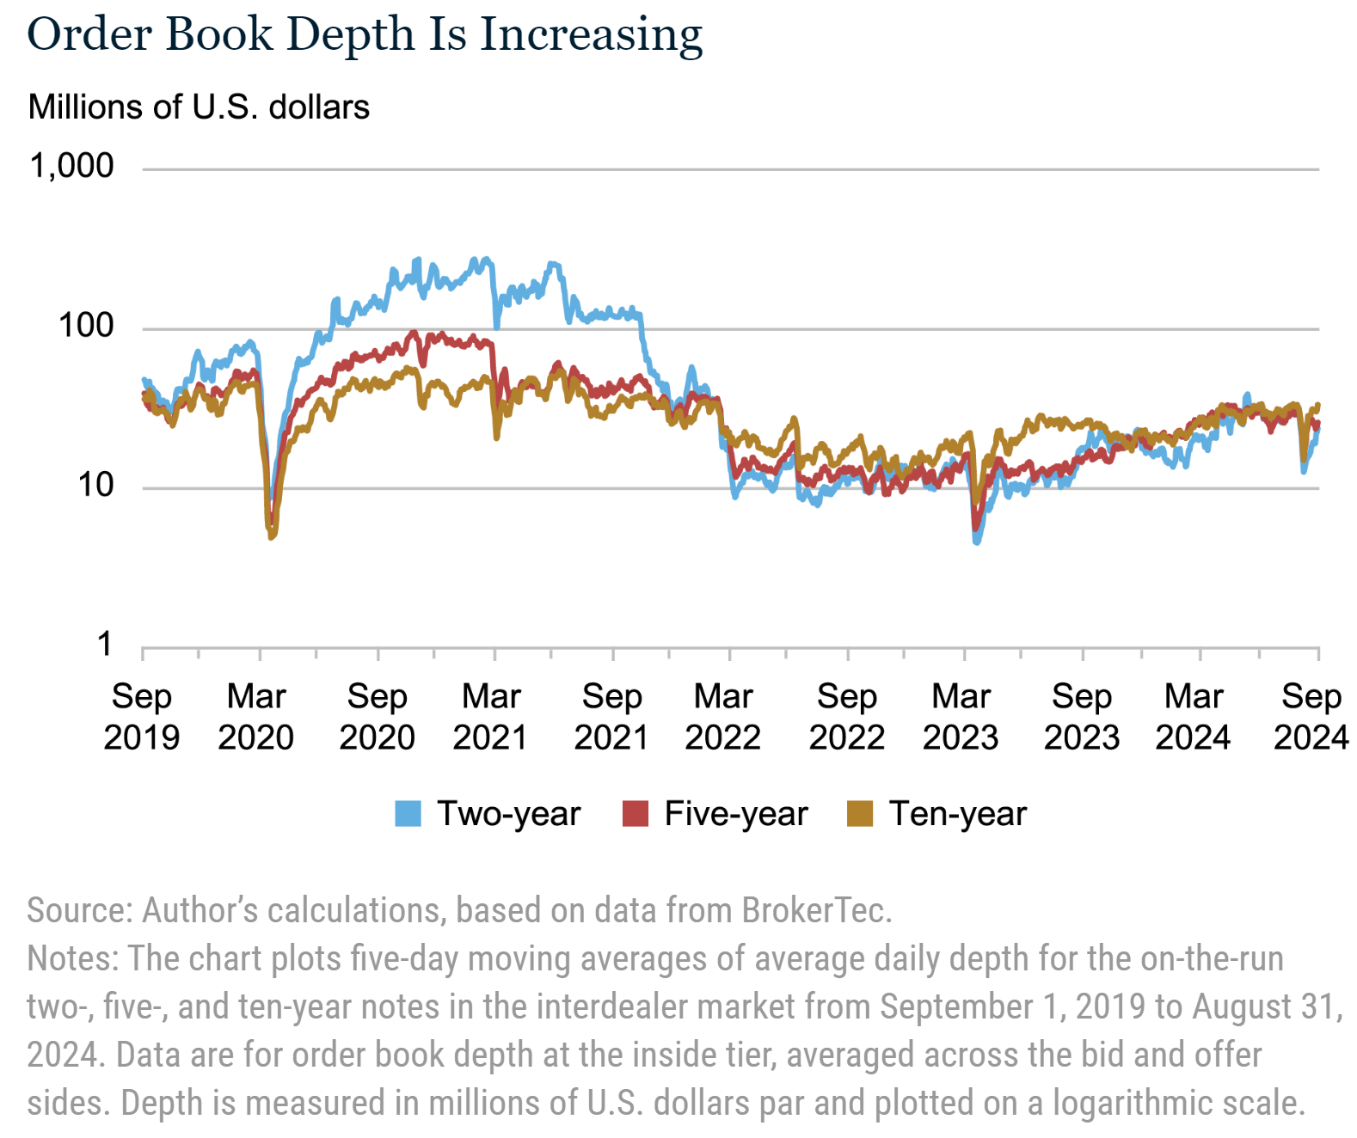
Treasury Market Liquidity Impaired
Source: Flemming. “Has Treasury Market Liquidity Improved in 2024?” FRBNY blog post.

Slide 14
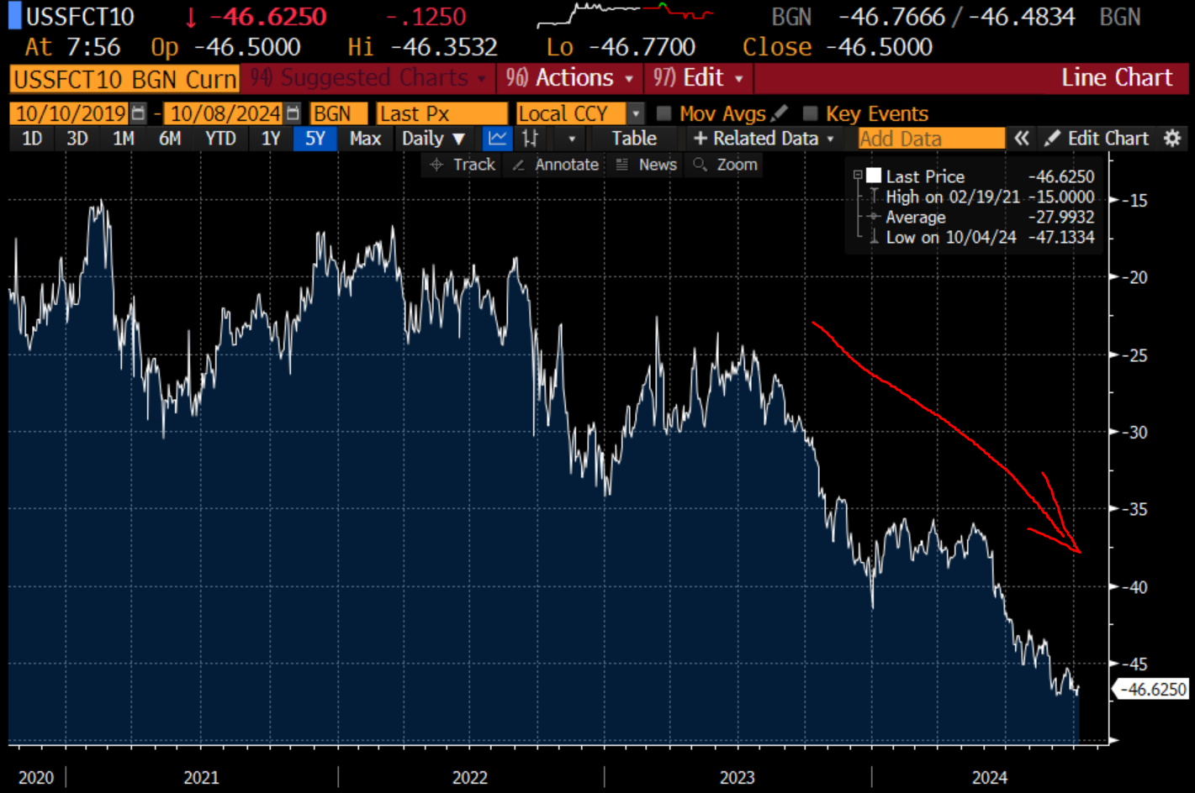
Rates Rising Relative to SOFR Swaps
Term Premia as measured by SOFR swap spreads (Estimated path of Fed policy less Treasury yields) has been rising.

Slide 15
Solutions: Banks “Encouraged” To Buy
Banks are common buyers of last resort for sovereign debt. An adjustment to regulations like the Supplementary Leverage Ratio would significantly increase bank appetite for Treasuries.
Vice Chair Barr has noted allowing banks to count liquidity from the Discount Window and Standing Repo Facility using Treasury collateral to count towards liquidity tests.
ISDA has been lobbying for leverage ratio exemptions for Treasuries, but that so far appears unlikely.

Slide 16
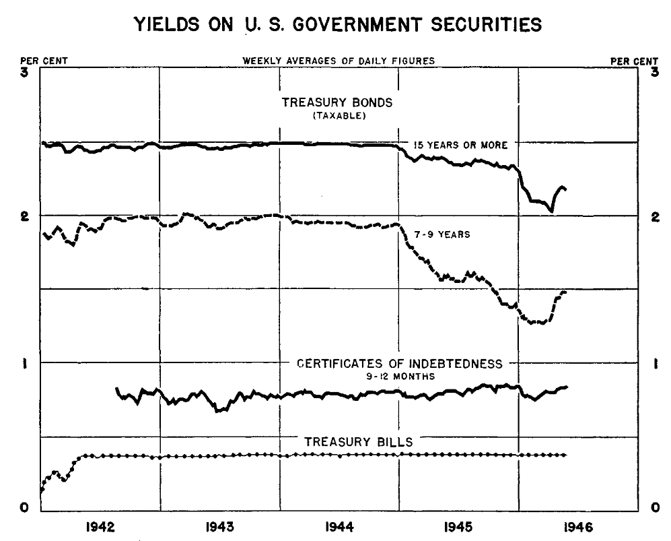
Solutions: Yield Curve Control
Fed once committed to support government financing by maintaining “a pattern of rates.” Short rates and longer dated rates were capped by the Fed. Most recently deployed in Japan and Australia.
Source: Federal Reserve Annual Report 1945

Slide 17
Big Fiscal Implies Strong Nominal GDP

Slide 18
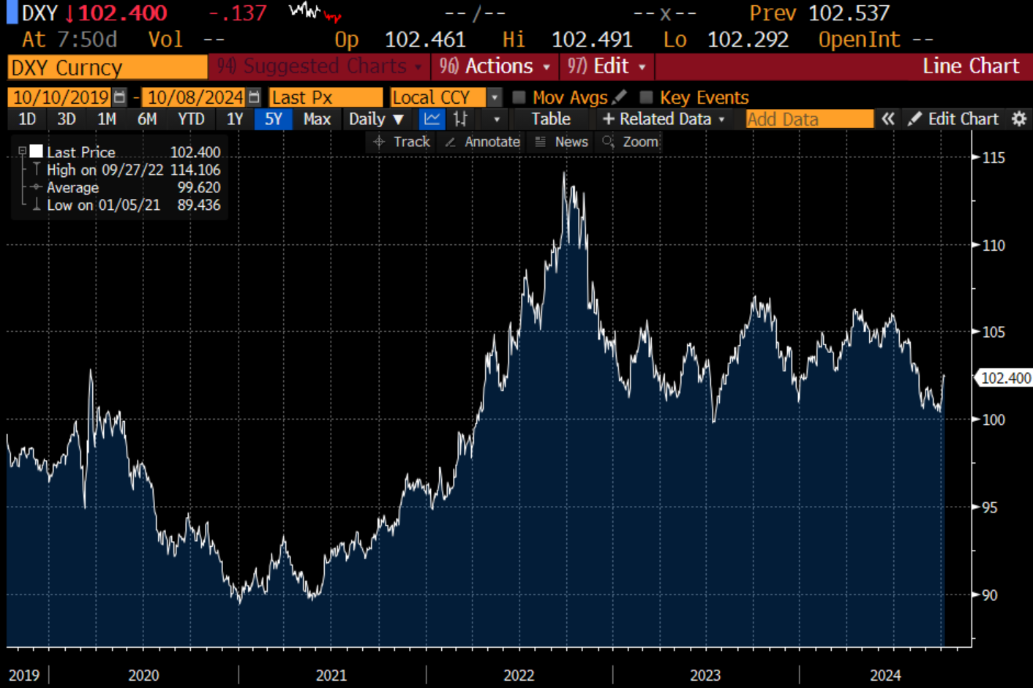
And A Weaker Dollar
A combination of an implied path of aggressive cuts and big deficit suggests a weaker dollar.

Slide 19
Which May Impact U.S. Assets
Foreign investors have substantial unhedged dollar exposure to U.S. assets.

Slide 20
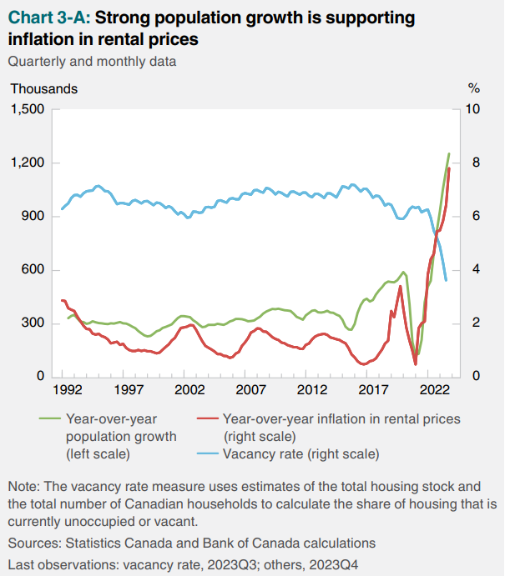
Politics: Adjustable Labor Supply
White House appears to control immigration through selective enforcement. This directly impacts growth, and inflation in certain sectors like shelter.
Source: Edelberg and Watson. “New immigration estimates help make sense of the pace of employment.” Brookings. Bank of Canada January 2024 Monetary Policy Report.

Slide 21
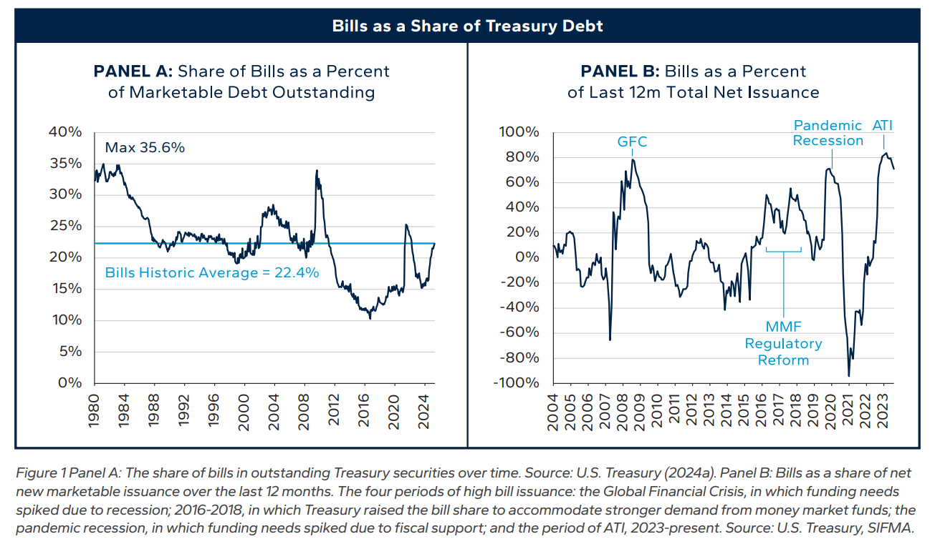
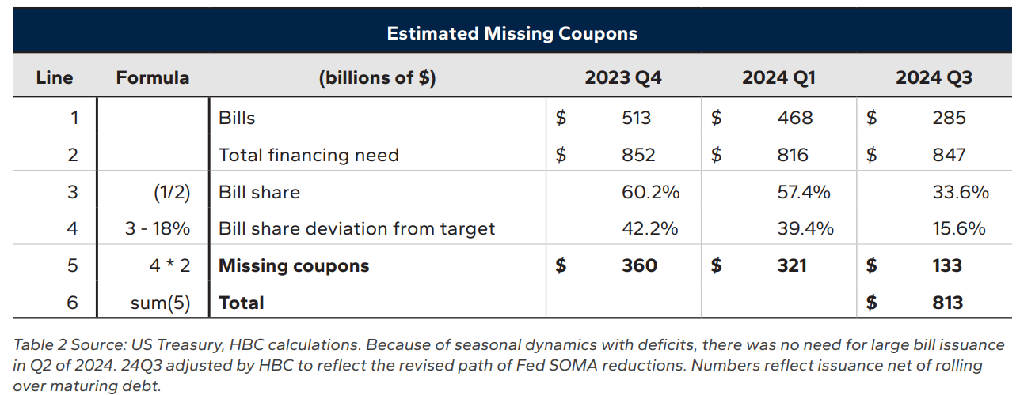
Politics: Activist Treasury Issuance
White House seems to be exercising greater control over Treasury duration, which gives it influence over financial conditions.
Source: Miran and Roubini. “ATI: Activist Treasury Issuance and the Tug-of-War Over Monetary Policy.” Hudson Bay Capital.

