Slide 1
FIASI Awards
Rick Rieder
April 18, 2013

Slide 2
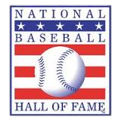

The Hall of Fame: The Sports Hall of Fame inductions are at the end of one’s career
A baseball player must have been active as a player in the Major Leagues at some time during a period beginning twenty (20) years before and ending five (5) years prior to election.
To be considered for induction by a screening committee, a player must be fully retired from play for at least five years, while a coach or referee must be fully retired for at least five years or if still an active full-time professional in his/her respective craft, have been active for a minimum of 25 years.

Slide 3

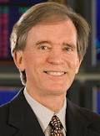
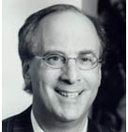
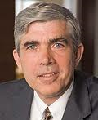

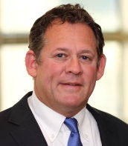
Short-Term Interest Rates
FIASI Hall of Fame – While you are in the middle of your prime ready to take on the opportunity in front of you…
Dan Fuss
2000 ~ 6%
Bill Gross
1995 ~ 6%
Larry Fink
2005 ~ 3%
Ken Leech
2007 ~ 5%
John Bogle
1999 ~ 5%
~ 0%
or in some cases
slightly negative

Slide 4
Some previous FIASI Hall of Fame winners and their academic accomplishments and discoveries…
Fischer Black
  Black-Scholes option pricing model
  Changed Wall Street forever by developing what is now known as “quantitative finance”
  Prominent mention in 1997 at Nobel Prize award given to co-authors
  Co-author of Black-Derman-Toy interest rate derivatives model developed by Goldman Sachs in the 80’s
  Graduated from Harvard College in ‘59 and received Ph.D. in Applied Mathematics from Harvard University in ‘64
Martin L. Leibowitz
  Prolific author of more than 150 articles, 10 of which received prestigious awards. In addition, author of numerous books including Inside the Yield Book co-authored with Sidney Homer.
  Transformed the markets’ understanding of bonds – developed Dedicated Portfolio Theory in the ‘80’s.
  Recipient of numerous awards as well as the first person inducted in the FIASI Hall of Fame
  Bachelors degree from the University of Chicago and Ph.D. from the Courant Institute of NYU
Robert Merton
  Received Nobel Prize in Economics in 1997; past President of the AFA, and member of the National Academy of Arts and Sciences
  Received the Alfred Nobel Memorial Prize in Economic Sciences in 1997 for expanding the Black-Scholes-Merton Formula
  Earned B.S. in Engineering Mathematics from Columbia University, M.S. from Caltech and Ph.D. in economics from MIT in 1970 under the guidance of Paul Samuelson
  Joined faculty of MIT until 1988 and moved to Harvard University in 1988

Slide 5

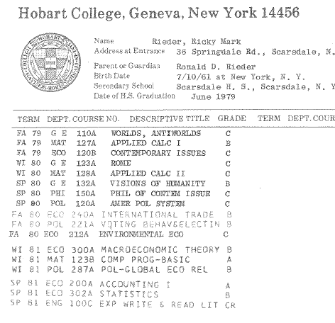
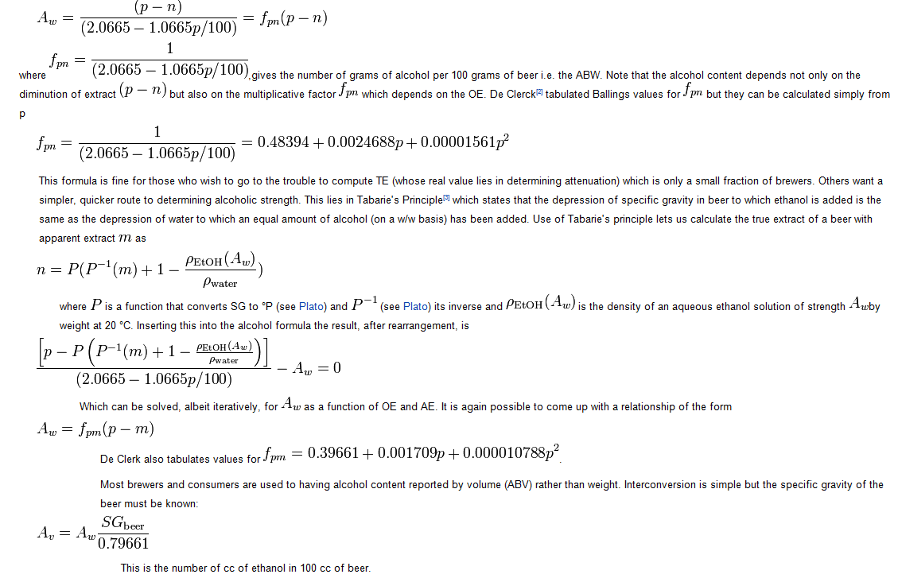
I was also able to make a discovery early in my academic career…
BEER
Rick
Rieder
Fischer Black
  Black-Scholes option pricing model
  Changed Wall Street forever by developing what is now known as “quantitative finance”
  Prominent mention in 1997 at Nobel Prize award given to co-authors
  Co-author of Black-Derman-Toy interest rate derivatives model developed by Goldman Sachs in the 80’s
  Graduated from Harvard College in ‘59 and received Ph.D. in Applied Mathematics from Harvard University in ‘64

Slide 6
Upon the news of my induction into the FIASI HALL, I received some truly sentimental notes…
Rick, I received an invite for your induction into the hall of fame. That’s pretty cool. Congrats! You’ve certainly worked hard enough…
actually, I think Deb should be the one inducted!!!
− Mike Gelband
Hey you SUCK. You’re being honored on April 18th
and I didn’t get the look (sic. Invited).
You’re f___ing dead!!!
I’m bending your golf clubs again…
− Anonymous
April 3, 2013

Slide 7
Tribute: I owe any success in my career truly to:
Originally designed for the Macintosh computer, the initial release was called "Presenter", developed by Dennis Austin and Thomas Rudkin of Forethought, Inc. In 1987, it was renamed to "PowerPoint"
“It's an effective way of communicating, teaching, and learning with a clear, simple and powerful display tool…”
Dennis Austin
Tomas Rudkin
“PowerPoint”

Slide 8
However, even with the current tax-drag from the fiscal cliff deal, spending cuts from the sequester, and this seasonal dynamic, is there any question that the US consumer will continue to spend, especially given current financial conditions???
Household wealth back to ‘07 peak
Household liquid assets to liabilities back above LT average
Debt service and interest income as a share of DPI
Domestic bank tangible equity trending up
Household buying power increased in 1Q13
US households beginning to take on more risk
 | 2002 | 2003 | 2004 | 2005 | 2006 | 2007 | 2008 | 2009 | 2010 | 2011 | 2012
Personal Income | 215 | 452 | 645 | 518 | 764 | 637 | 199 | -474 | 644 | 508 | 646
Less Interest | -13 | -2 | 17 | 13 | 26 | 26 | -38 | -21 | -36 | -3 | 4
Mortgage Interest | 27 | 14 | 49 | 74 | 84 | 36 | -18 | -57 | -35 | -38 | -48
Personal Taxes | -186 | -25 | 74 | 163 | 140 | 125 | -95 | -291 | 106 | 182 | 87
= Cash flow | 386 | 465 | 505 | 268 | 515 | 451 | 350 | -105 | 609 | 367 | 603
+ Consumer credit | 96 | 103 | 111 | 95 | 97 | 138 | 9 | -185 | -27 | -23 | 42
+ RE Equity | 577 | 718 | 1547 | 2026 | -321 | -2556 | -3182 | -253 | -51 | -168 | 1644
HH Buying Power | 1060 | 1286 | 2163 | 2389 | 290 | -1968 | -2823 | -542 | 530 | 176 | 2289
Nominal Consumption | 286 | 408 | 513 | 522 | 461 | 492 | -87 | 101 | 439 | 472 | 381
Source: CS; DB; Bloomberg; DB; Federal Reserve, CS
Not only is the housing sector buoying this consumer spending dynamic, it is also contributing to a banking sector that today has a much more solid balance sheet foundation, is flush with cash, and has a substantial ability (and desire) to lend (acquire assets)…
For use with Institutional and Professional Investors Only - Proprietary and Confidential

Slide 9
I am truly proud of being here and in this industry…
The top 15 financial services firms included in the Foundation Center's ranking of corporations based on grant making and contributions in 2010, included banks, a diversified financial company and insurers. Together these firms accounted for $881mm in contributions, or about one-third of the $2.6bn identified by the Foundation Center.
There are >30,000 non-profit organizations in NYC alone… many of these are funded or board-represented by people in the Finance industry…
Many are in this room tonight…

Slide 10
No one else’s career has had such great fortune of being associated with the highest quality people in this industry/world…
Billy Prather
Greg Hall
Raphael Yan
Ron Sion
Kevin Holt
Scott Thiel
Robert Stanley
Mo Grimeh
Mike Gelband
Edwin Conway
Scott Best
Yury Geyman
Peter Hayes
Kevin Ecclesine
Rob Kapito
Larry Fink
Bob Miller
Sagar Shah
Michael Keeney
Terry Keeley
Bill Cronin
Mark Bevere
Charlie Hallac
Mayor Cory Booker
Preston Hutchings
Richie Prager
Jeff Jacobs
Paul Tudor Jones
Debbie Goldfarb
Rich Kushel
Brian Weinstein
Quintin Price
Akiva Dickstein
Mike Weaver
Matt Wang
Adam Bobker
Patrick Frayne
Larry Evans
Bart McDade
John Stein
Chris Kelly
Mike Ryan
Frank Porcelli
Trevor Slaven
Wendy Bevere
Catherine Keary
Rob Goldstein
Tom Russo
Ewen Cameron Watt
Alex Shingler
Connor Fitzgerald
Kevin Becker
Lee Kempler
Stu Spodek
Howard Surloff
Julianne Rusie
Rob Fairbairn
Jimmy Keenan
Ben Golub
Samir Lakhani
Tom Humphrey
Brian Collins
Steve Sterling
Kevin White
Russ Brownback
Chris Winchenbaugh
Michael Phelps
John Burger
Steve Lessing
Mark Fishman
Dez Desai
Jeff Rosenberg
Paul Tice
Shayan Hussain
Lauren Post
Bill Milliken
Annelise Eschmann
Jeff Cucunato
Josh Tarnow
Peter Fisher
Randy Robertson
Ron Redmond

Slide 11
Thank you

