Slide 1
VIRTUAL EVENT
Fixed Income Analysts Society & Bloomberg Intelligence Credit Research
March 29, 2023

Slide 2
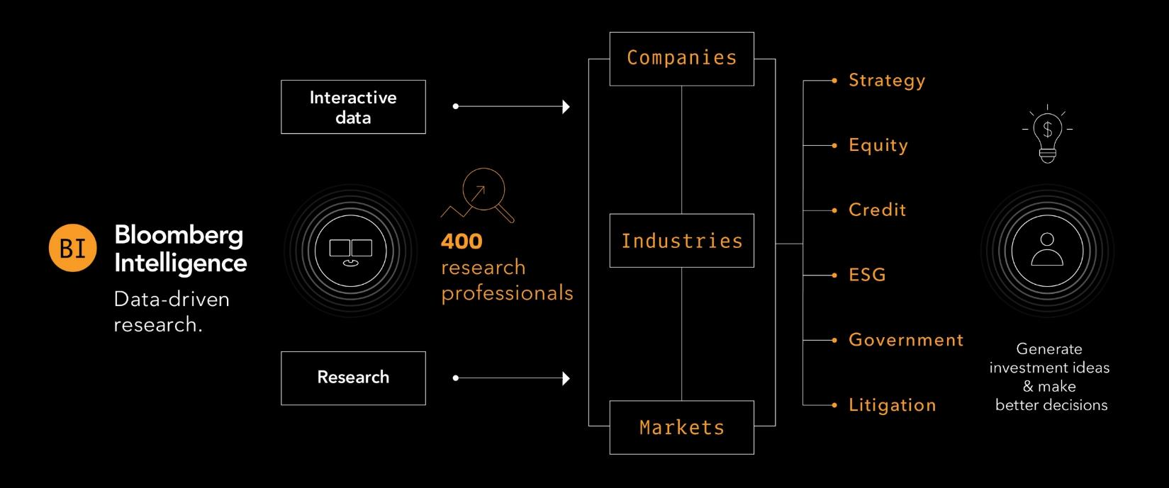
Bloomberg Intelligence
500+
data contributors
135+
industries
2,000+
companies
15yrs
avg. analyst experience
Bloomberg Intelligence (BI) research delivers an independent perspective providing interactive data and investment research on companies, industries and global markets. Our team of 400 research professionals help our clients make informed decisions in the rapidly moving investment landscape.

Slide 3
Agenda
  Introduction to BI Credit Research
  Team Member Presentations:
  1. Banking Turmoil and Ripple Effects Across Financials
  2. Health and Outlook of the Global Consumer with the impact on Consumer & Industrial Sectors
  3. Energy Discussion and important capital allocation decisions that need to be made
  4. Relative value update on the TMT sector, including how to optimize Bloomberg functionality and data
  Q&A

Slide 4

Banking Turmoil and Ripple Effects Across Financials
Arnold Kakuda
US Banks Credit Analyst
Bloomberg Intelligence

Slide 5
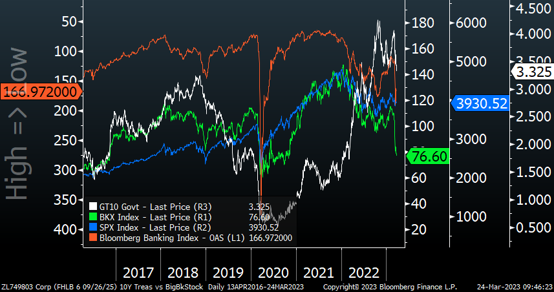
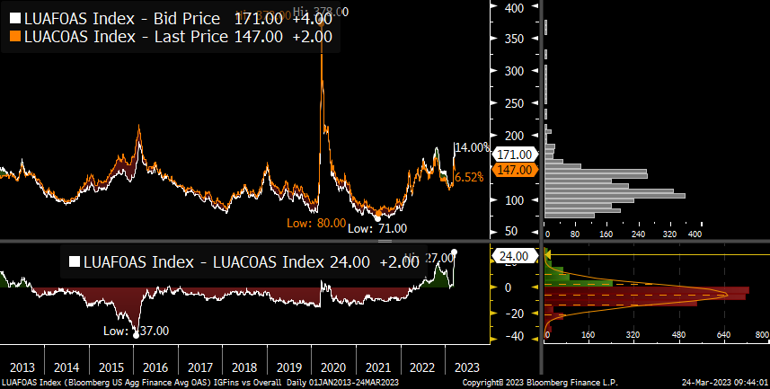
Financial Bonds (Excluding AT1/Preferreds) Over 20 Bps Wide Vs. Overall IG Index
Bank Stocks, Bond Spreads, S&P 500, 10Y UST
Fins Spreads Used to Be Tight to Corporate Index
Source: Bloomberg

Slide 6
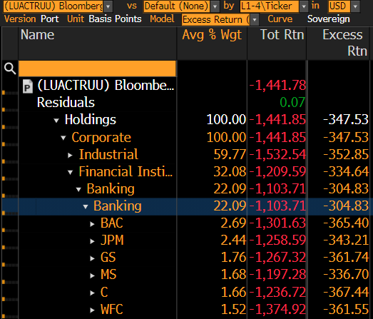
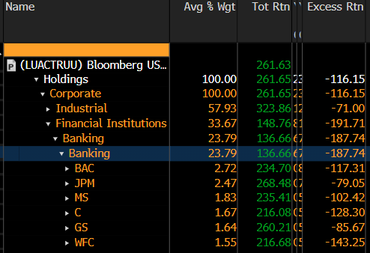
March Total Returns Positive While Excess Returns Negative
Big U.S. Banks March 23: Total & Excess Returns
Source: Bloomberg

Slide 7
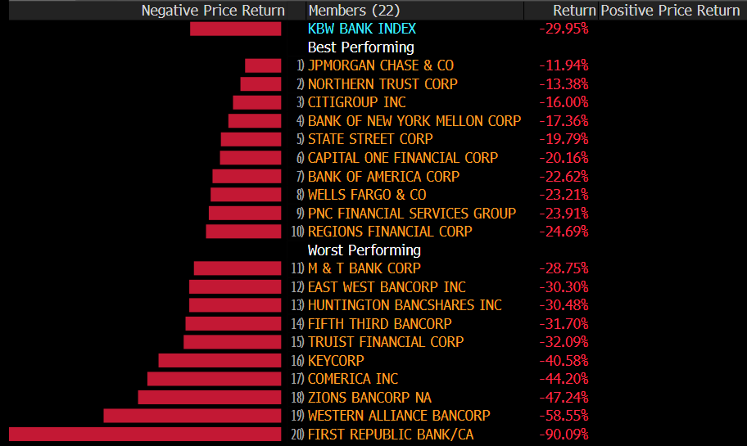
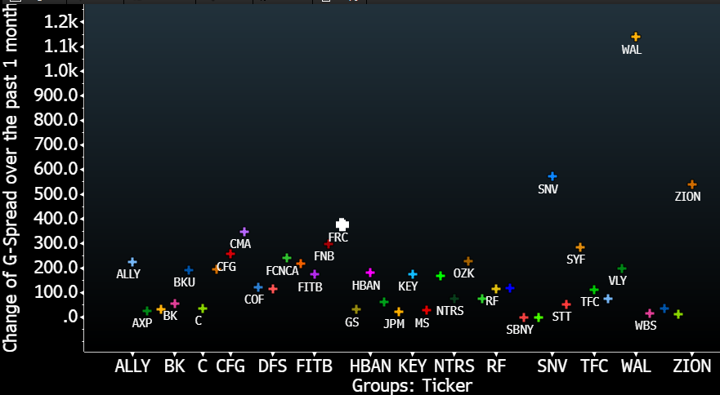
Biggest US Banks Provide a Shelter From Regional Worries
Bank Index: 1 Month Stock Change
USD Bank Bonds: 1 Month G-Spread Change
Source: Bloomberg

Slide 8
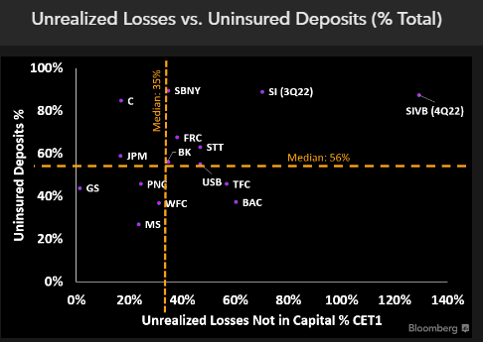
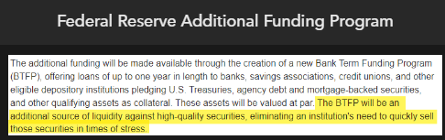
Select Regional Banks Faced Uninsured Deposit Outflow on Unrealized Loss Concerns; BTFP a One Year Band Aid
Source: Bloomberg Intelligence, Company Filings, Federal Reserve

Slide 9

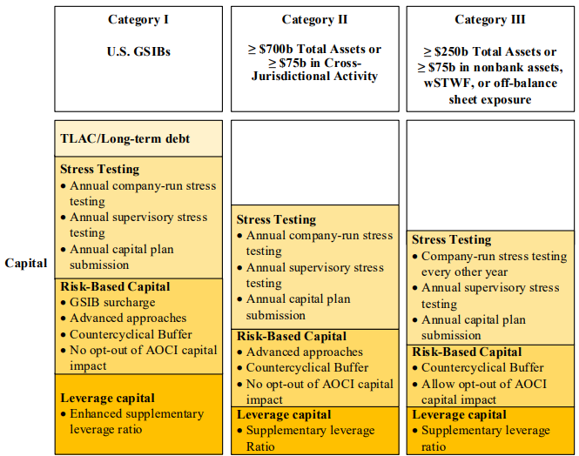
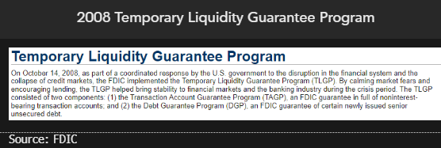
Potential Cure for Regional Bank Jitters May Be More Deposit Guarantees, Regulation (TLAC, AOCI), Lower Rates

Slide 10
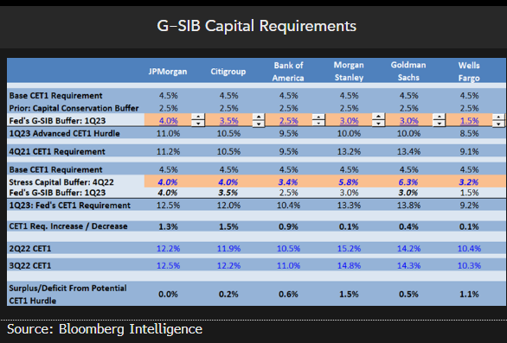
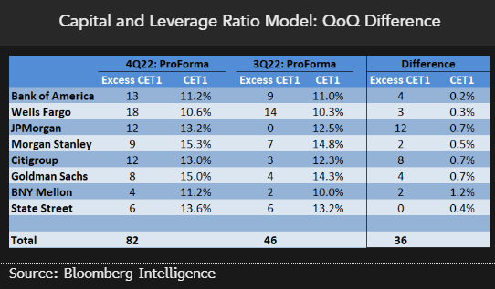
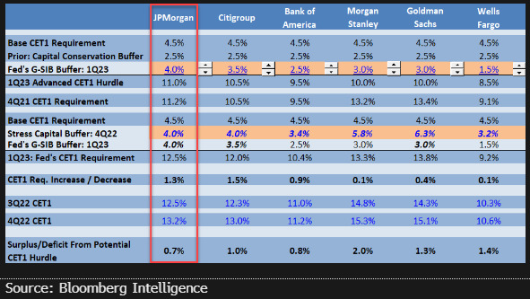
Biggest US Banks Have Healthy Excess CET1, Which Include Unrealized Losses From AFS Securities, Unlike Regionals

Slide 11
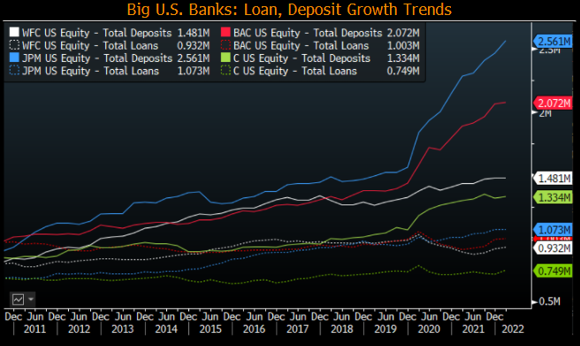
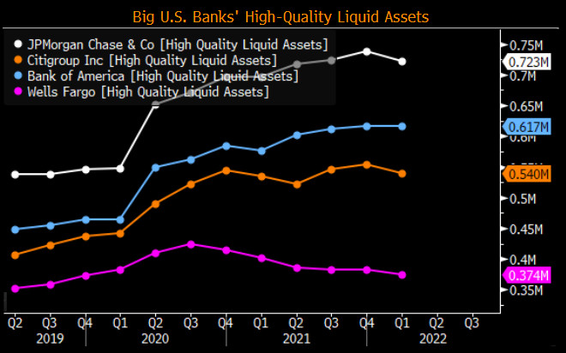
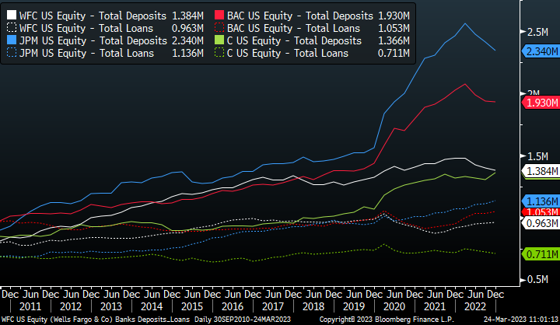
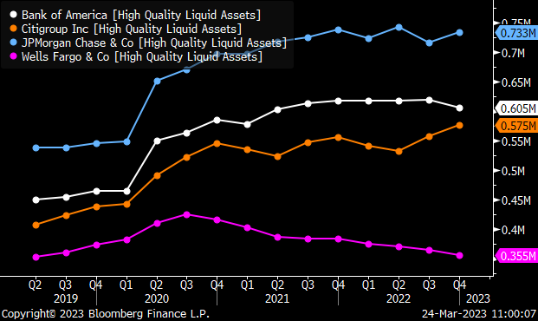
Biggest US Banks’ Liquidity Remains Healthy as Balance Sheets “Normalize”
TO BE Updated
Source: Bloomberg Intelligence, Company Filings

Slide 12

Banking Turmoil and Ripple Effects Across Financials
David Havens
US Financials Credit Analyst
Bloomberg Intelligence

Slide 13
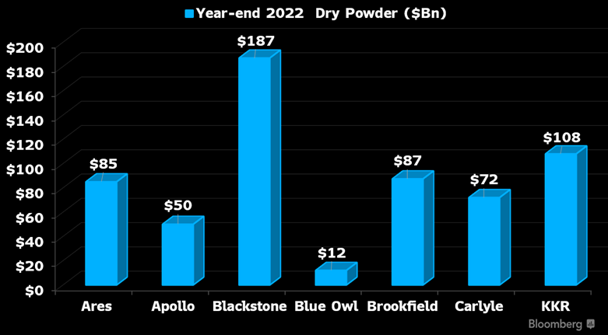
For Alternative Asset Managers – A Double-edged Sword

Slide 14
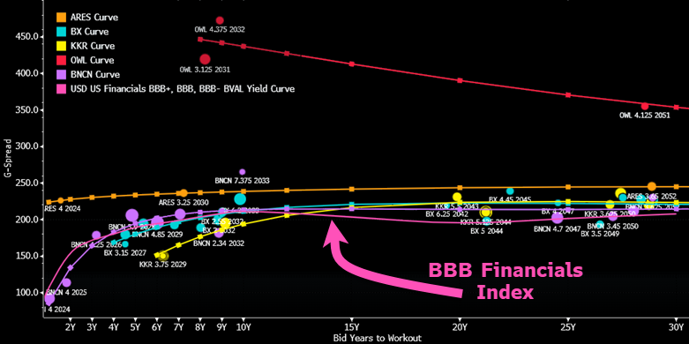

Alternative Asset Managers Trade Like BBBs, Or Worse

Slide 15
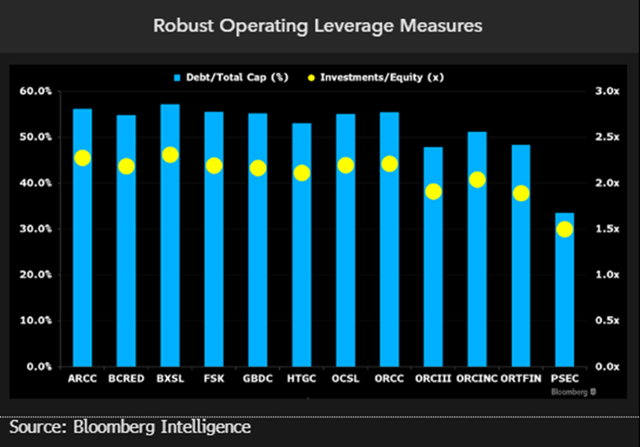
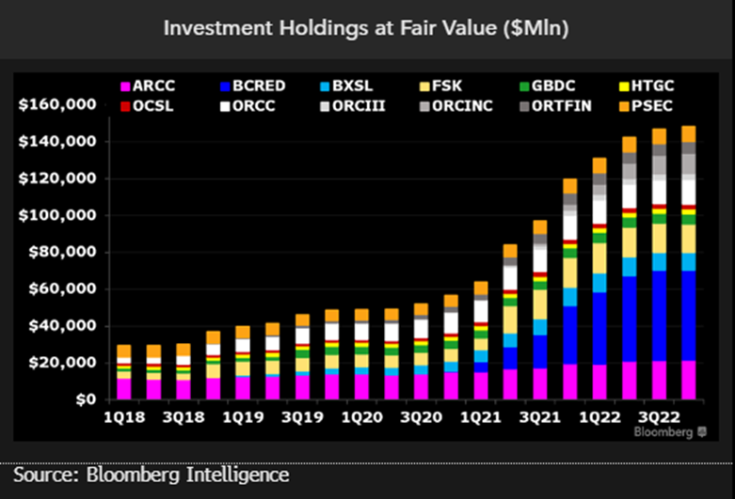
Dark Age or Golden Age for Private Credit?

Slide 16
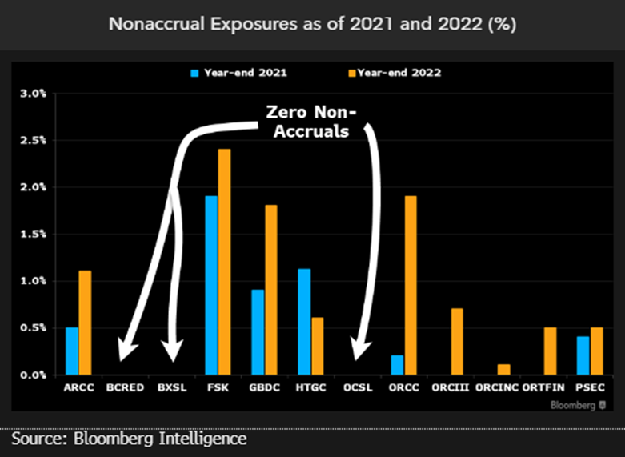
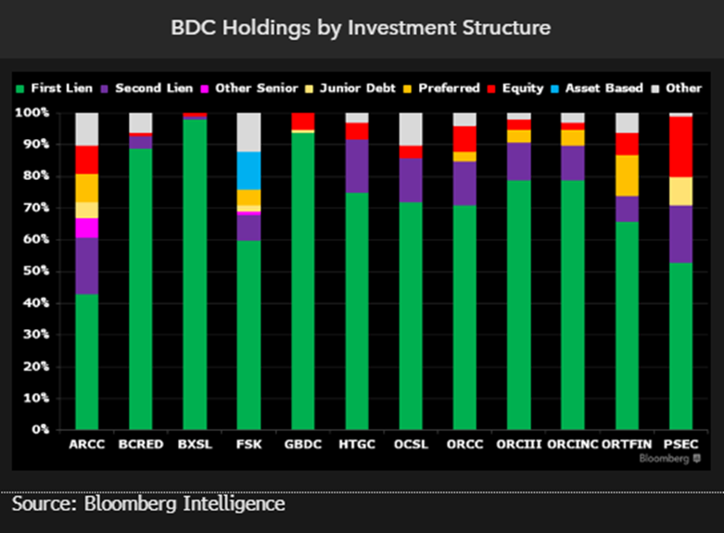
Dark Age or Golden Age for Private Credit?

Slide 17
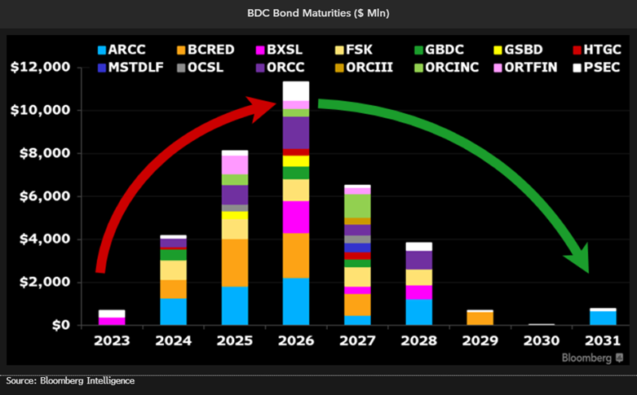
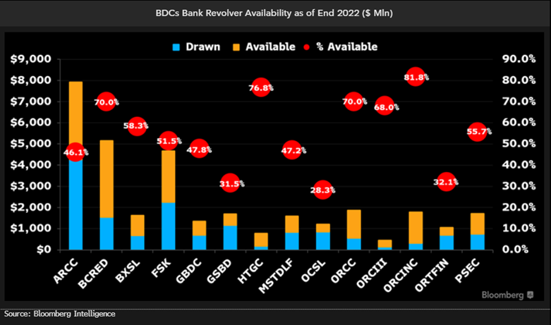
Dark Age or Golden Age for Private Credit?

Slide 18
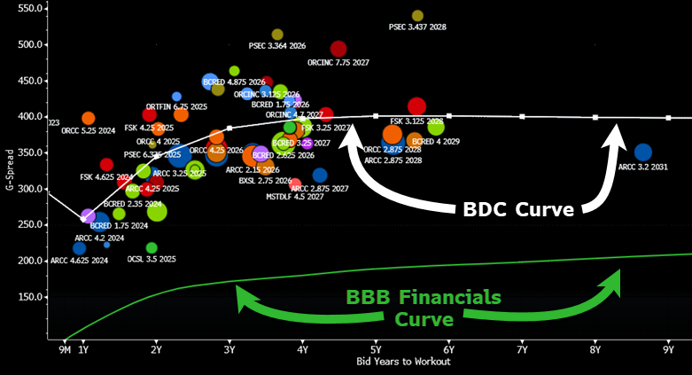
Dark Age or Golden Age for Private Credit?

Slide 19

Banking Turmoil and Ripple Effects Across Financials
Himanshu Bakshi
Global Financials Credit Analyst
Bloomberg Intelligence

Slide 20
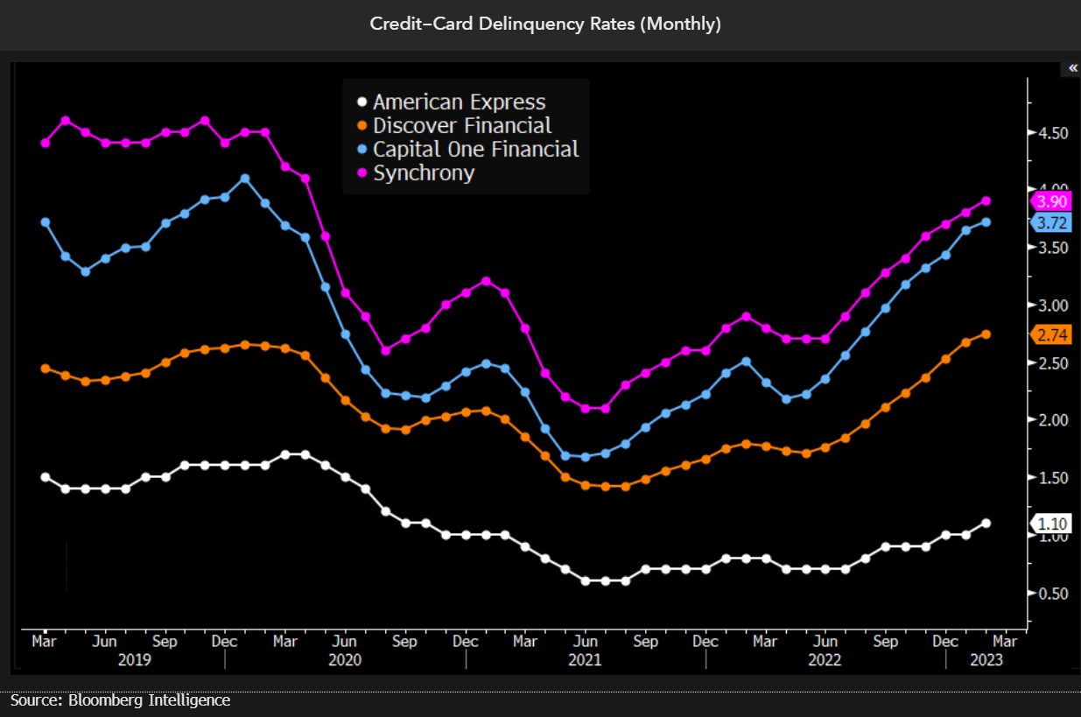
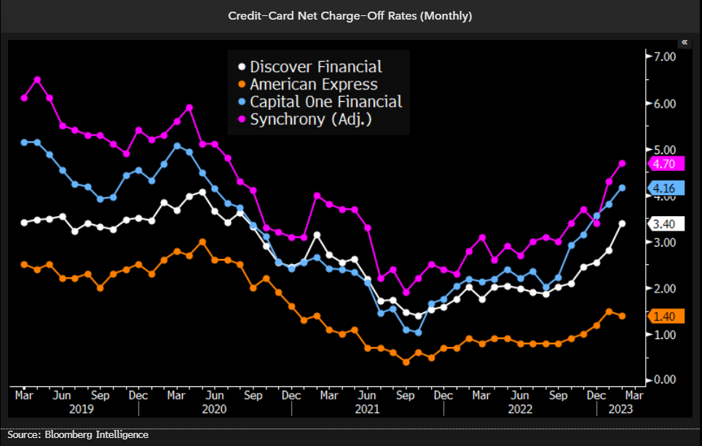
Banking Crisis All at Once, But Quiet on the Card Front, for Now

Slide 21
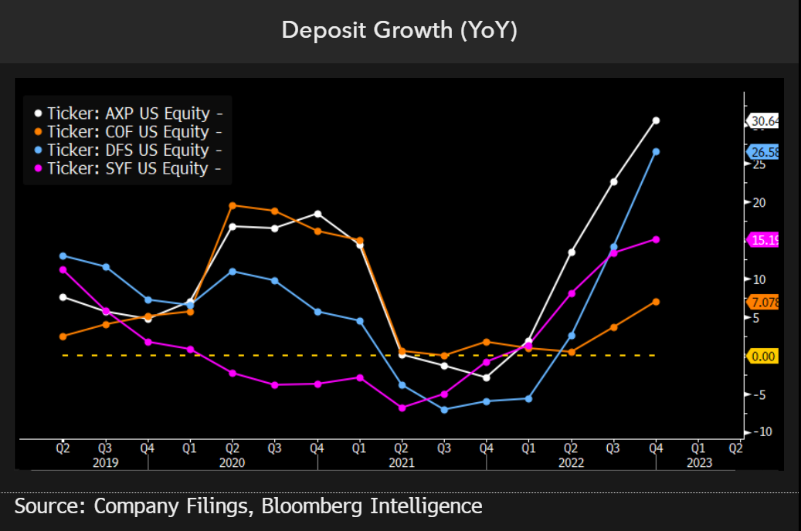
Card Issuers' Deposits Are Less Stable, But Flight Risk Is Low

Slide 22
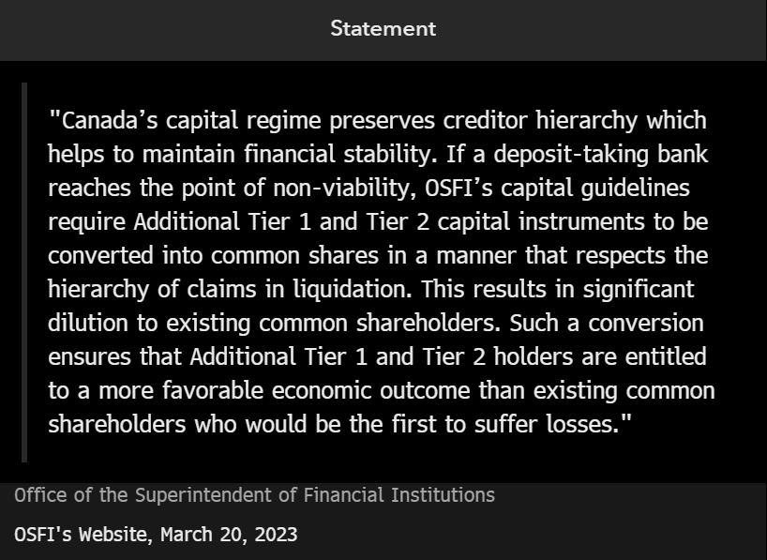
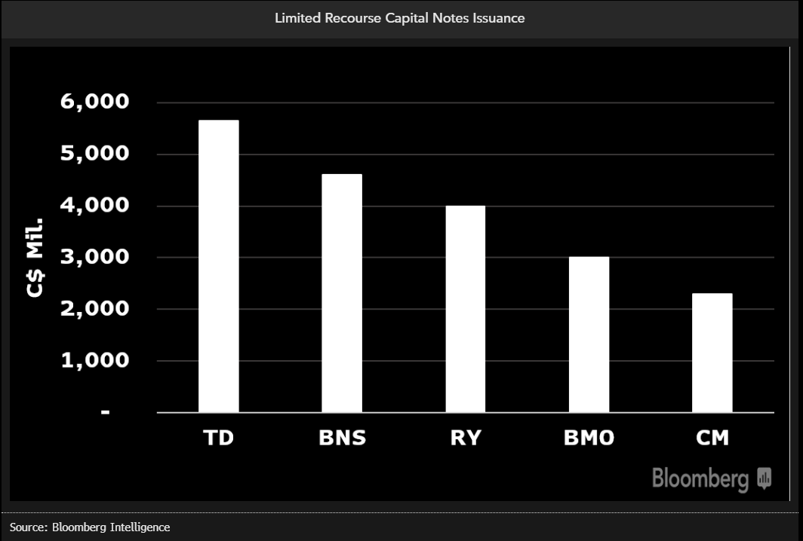
Canadian Banks' AT1 Wouldn't Meet Same Fate as at Credit Suisse

Slide 23
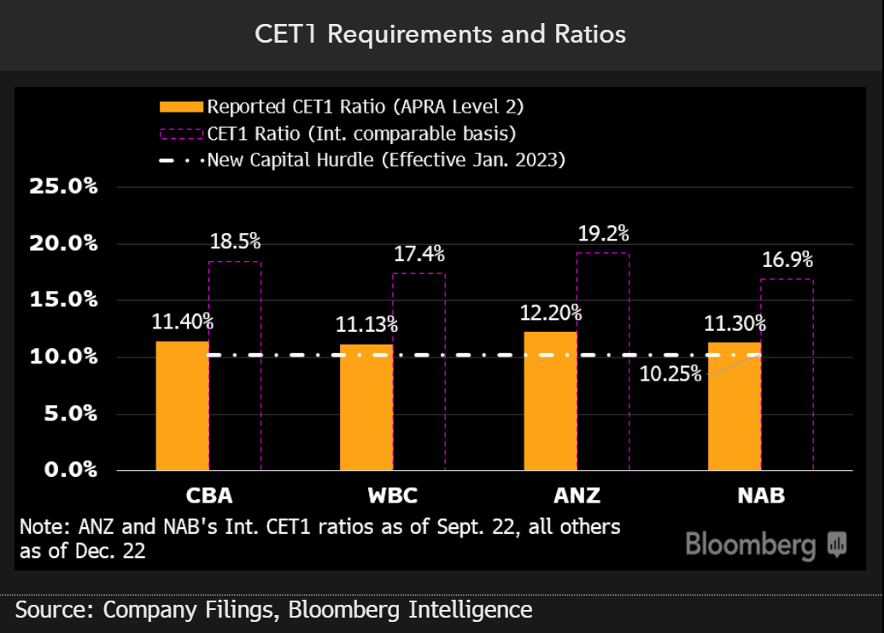
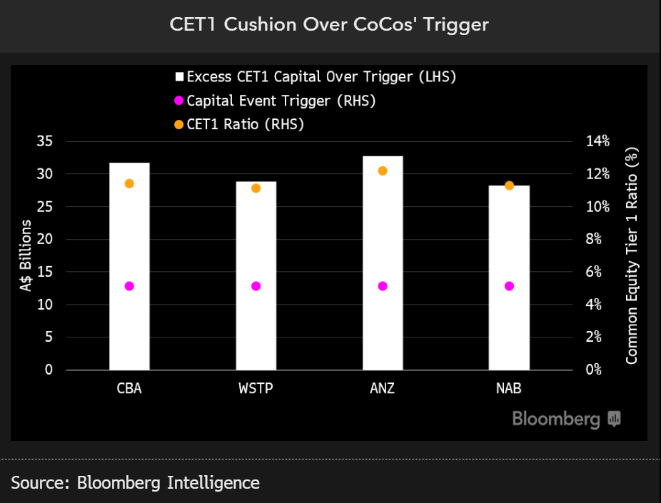
CoCos Down Under? A$30 Billion AT1 Cushion for Australian Banks

Slide 24

Health and Outlook of the Global Consumer with the impact on Consumer & Industrial Sectors
Mike Holland
Healthcare Credit Analyst
Bloomberg Intelligence

Slide 25
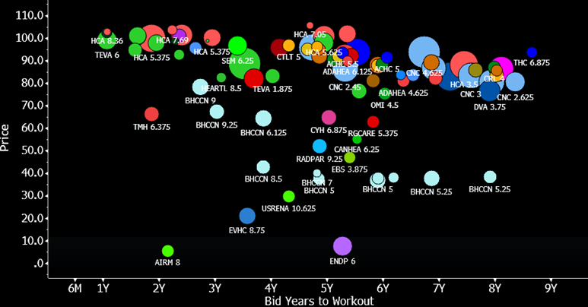
High Yield Bond Prices Still Heavy….

Slide 26
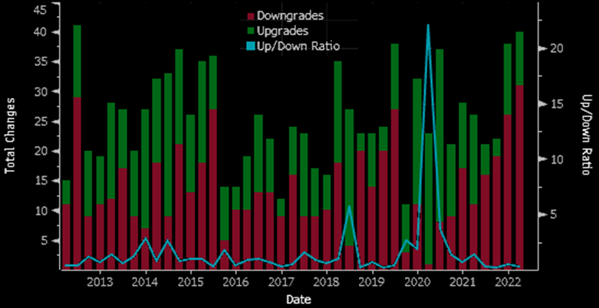
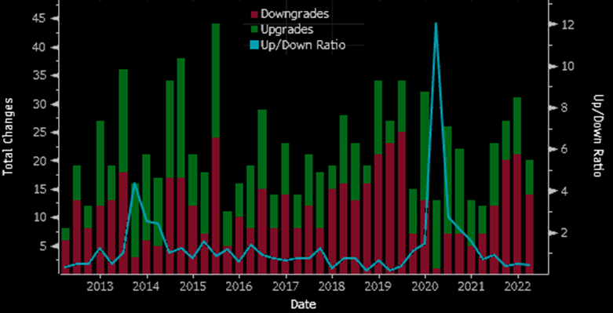
Negative Ratings Trends Across Both HY and IG…
Moody’s Healthcare Trends
S&P’s Healthcare Trends
Notes:
Moodys, 9 upgrades to 31 downgrades, for IG 4 up and 7 down, for HY, 4 up and 22 down
Notable downgrades: HY: Elanco, Grifols, Cano, CYH,, Sotera, Select Medical
IG: Pfizer (negative outlook), Fresenius, Amgen (buying Horizon), Surgery Center
Notable upgrades: Surgery Partners (outlook pos)
S&P: 6 up, 14 down, for IG, 1 up 2 down, for HY 4 up 12 down
Notable upgrades: Acadia
Notable downgrades: CYH, Bausch

Slide 27
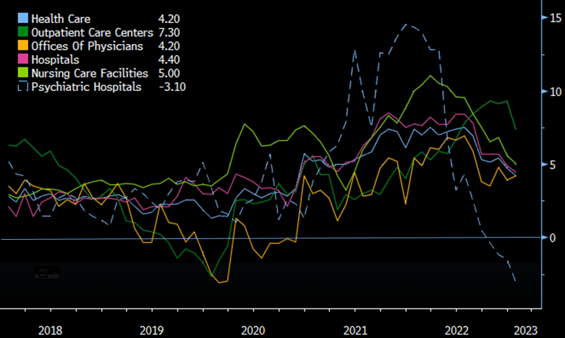
Labor Costs Declining Off Peak…
Notes:
The health-care industry's average hourly wage growth decreased 50 bps to 4.2% in January, a level that should notably aid health-care providers' margin relative to expectations. Labor cost growth peaked for the sector in March 2022 over 10%.
Wage growth in a hospital setting declined 50 bps to 4.4% in January with pay in ambulatory settings - though still highest across the providers’ landscape - declining 200 bps sequentially.

Slide 28
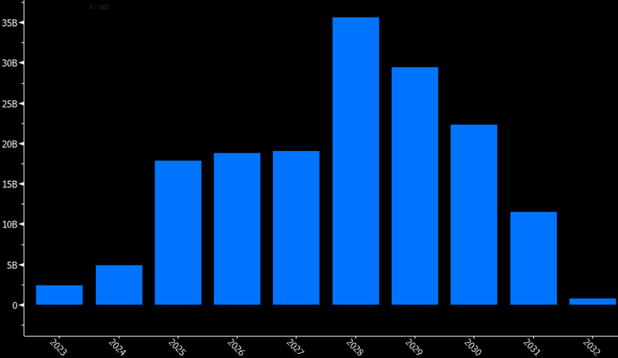
Near-Term Refi Risk Low for High Yield Healthcare…
Notes:
2023 maturities for high yield healthcare bonds stand around $2.4 billion remaining in 2023, between about 2bn for Teva and 345 million for Elanco. There’s $5 billion due in 2024, before picking up to $18 billion in 2025, an amount that‘s declined by about 4.5 billion over the past several months as companies chip away at that maturity wall.

Slide 29
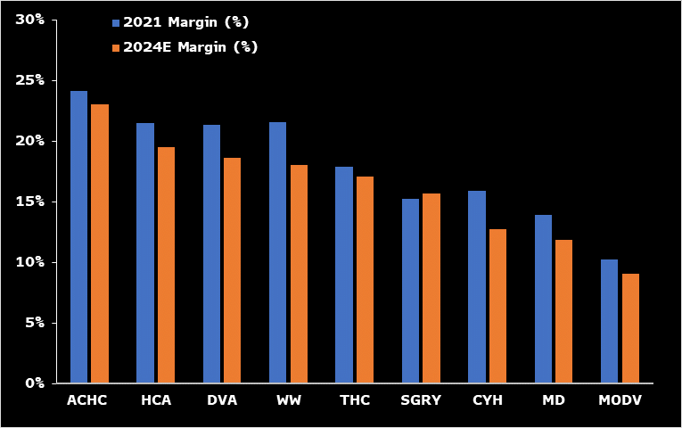
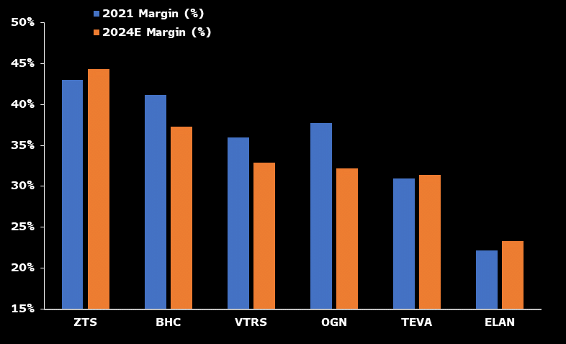
Thinning Margins for Providers, As Pharma’s Mixed…
Provider Adjusted Ebitda Margins (%)
Pharma Adjusted Ebitda Margins (%)
Source: Bloomberg Data, Bloomberg Estimates
Notes:
Provider Adjusted Ebitda Margins (%)
Pharma Adjusted Ebitda Margins (%)

Slide 30
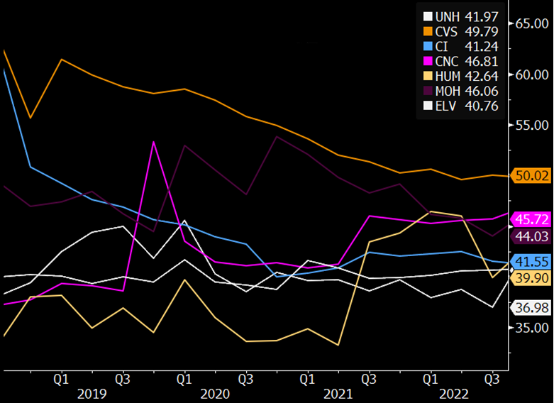
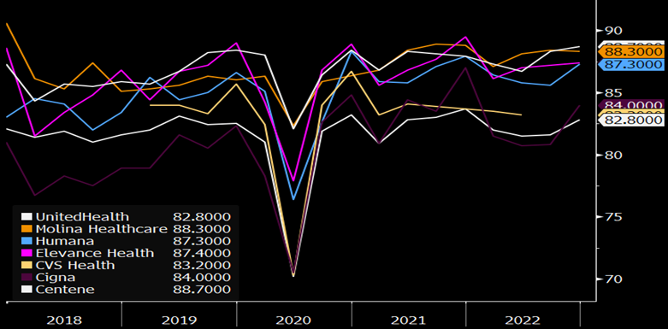
Payors’ Debt To Cap and MLRs Normalizing…
Debt to Capital Ratios
Medical Loss Ratios (%)
Notes:
Debt to Capital Ratios
Medical Loss Ratios (%)

Slide 31
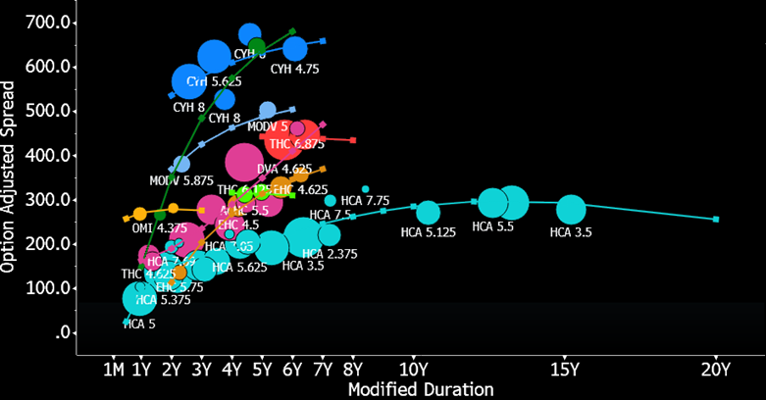
Provider Spreads Reflect Fundamental Dispersion…

Slide 32
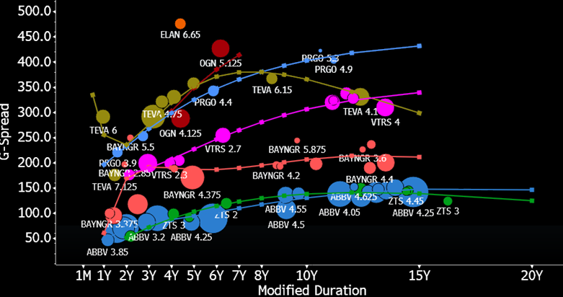
Pharma Spreads, Excluding Distressed Outliers…
Notes:
Exlcudes Bausch, whose bonds trading over 1,000 basis points

Slide 33
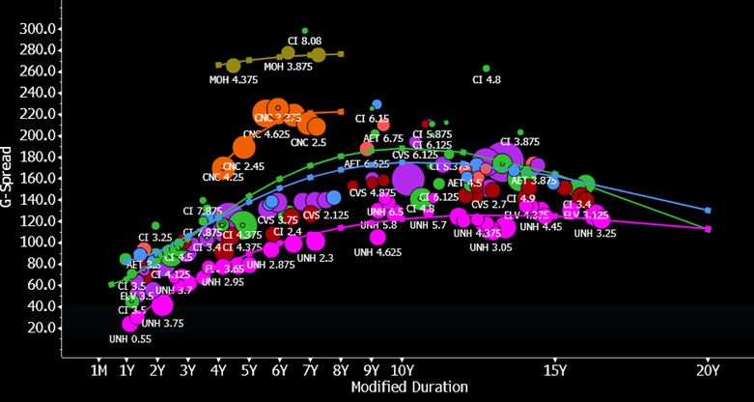
Payor Spreads Relatively Resilient So Far in 2023

Slide 34

Health and Outlook of the Global Consumer with the impact on Consumer & Industrial Sectors
Jody Lurie
Leisure, Lodging, Gaming, Restaurants, & Rental Cars Credit Analyst
Bloomberg Intelligence

Slide 35
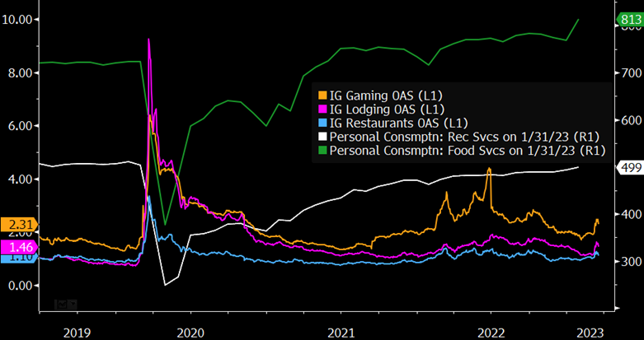
Economic Backdrop: Company Thinking and the Consumer
Topics of Focus By Management Teams
Consumer Spending vs. Credit Spreads
Source: Bloomberg Intelligence; Bloomberg transcript analyzer (TA<GO>) in earnings call, conference/presentation, shareholder meeting, M&A call for related words to each category; tickers CAR, CCL, CHH, CZR, DRI, FUN, H, HLT, HTZ, LVS, MAR, MCD, MGM, NCLH, RCL, SBUX, SEAS, SIX, STAY, TNL, WYNN, YUM; *1Q22 through 03/21/2023
Access right chart G #BI 109050 on the Terminal: https://bloom.bg/3H8PnVy

Slide 36
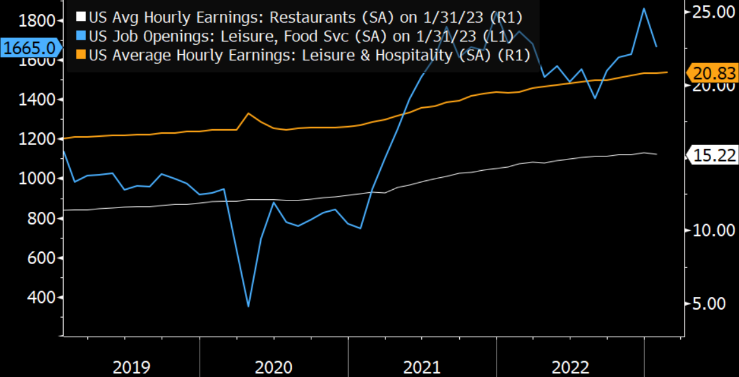
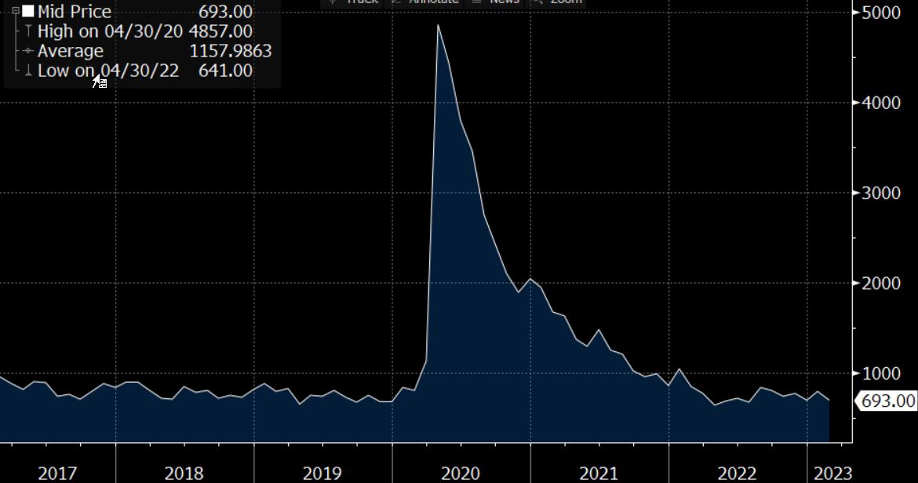
Labor Shortages and Wage Inflation
Leisure Hourly Earnings vs Job Openings
Leisure & Hospitality Unemployment
Source: Bloomberg Intelligence; Access left chart G #BI 111215 on the Terminal: https://bloom.bg/3BrloUw
Access right chart UEMPLEIS Index GP on the Terminal: https://bloom.bg/3bWHTq7

Slide 37
Universe Ratings Matrix
High Grade
High Yield
Source: Bloomberg Intelligence

Slide 38
Margins: 2019 vs 2023-24 Estimates
Source: Bloomberg Intelligence; EEO<GO> and MODL<GO> screens on the Terminal for BEst numbers

Slide 39
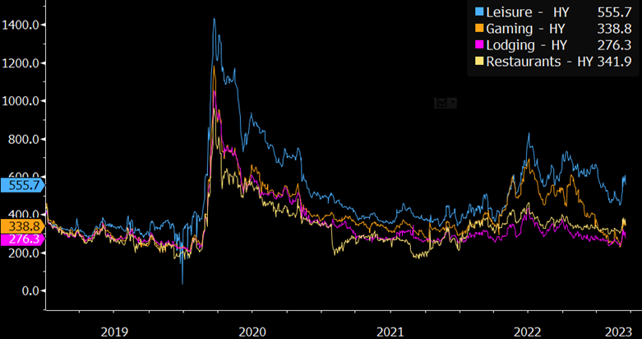
High Yield Credit Spreads Over Time
Source: Bloomberg Intelligence; Access G #BI 109210 chart on the Terminal: https://bloom.bg/3krgRf7

Slide 40
Sector Issuance Volumes Since 2017
Source: Bloomberg Intelligence; SRCH<GO> and LEAG<GO> custom searches from 01/01/2017 to 03/16/2023

Slide 41
Cash Sources and Uses
Subsector Cash Sources/Uses: 2022 (Above), 2020 (Below)
Average Leisure Sector Cash Sources/Uses
Source: Bloomberg Intelligence; Used FA<GO> data and screened in EQS<GO> on the Terminal for companies based in the U.S. with at least $1B in long-term debt outstanding a/o YE2021: Restaurants and Bars, Travel and Tourism, Casinos and Gambling, Hotels and Motels, Recreational Services, Rental and Leasing Services: Consumer

Slide 42




















Credits Under Coverage
Rental Cars
Restaurants
Hotels
Casinos
Cruise Lines
Theme Parks
Source: Bloomberg Intelligence, company websites
Notes:
Reminder of our sector coverage

Slide 43

Health and Outlook of the Global Consumer with the impact on Consumer & Industrial Sectors
Mike Campellone
US Retail Credit Analyst
Bloomberg Intelligence

Slide 44

Health of US Consumer: US Credit Card Debt: Quarterly Change
Source: Bloomberg Intelligence; FRBNY Consumer Credit Panel / Equifax Read Research Report: Click Here

Slide 45


Credit Card Transaction Data Shows a Shift in Spending
(Dollar Volume Growth YoY% - SSS by Industry)
Source: Bloomberg Intelligence; Fiserv SpendTrend, Read Research Report: Click Here

Slide 46

Excess Inventory a Risk to Retailer Profitability
Source: Bloomberg Intelligence; Read Research Report: Click Here

Slide 47

US Retail Bond Spreads Spike as Spending Slows
Source: Bloomberg Intelligence; Read Research Report: Click Here

Slide 48

Health and Outlook of the Global Consumer with the impact on Consumer & Industrial Sectors
Matt Geudtner
Industrials Credit Analyst
Bloomberg Intelligence

Slide 49

Aerospace

Slide 50

Boeing

Slide 51

Boeing
Source: Bloomberg Intelligence, Bloomberg Estimates

Slide 52

Boeing

Slide 53

Boeing

Slide 54

Howmet
Source: Bloomberg Intelligence, Company Filings, Bloomberg Estimates

Slide 55

Howmet

Slide 56

Energy Discussion and important capital allocation decisions that need to be made
Spencer Cutter
Energy Credit Analyst
Bloomberg Intelligence

Slide 57

2008 GFC – Oil Plunged, Spreads Widened, but…

Slide 58

2008 GFC – Energy Was Still A “Safe Haven”

Slide 59

Independent Energy - Where Is The Market Today?

Slide 60


Strong Balance Sheets Entering 2023

Slide 61

Sustainable Free Cash Flow at $50 Oil

Slide 62

What About Natural Gas?

Slide 63

Credit Metrics Expected to Remain Solid
Source: Bloomberg Data, Bloomberg Estimates

Slide 64

Borrowing Base Breathing Room
Source: Bloomberg Data

Slide 65

Relative value update on the TMT sector, including how to optimize Bloomberg functionality and data
Stephen Flynn
Telecom & Media Credit Analyst
Bloomberg Intelligence

Slide 66

Netflix: Bond Spreads Tight or Just Right?

Slide 67
Netflix: Credit Summary
Netflix has $8.9 billion of US$ denominated unsecured bonds due 2024-30
Notes are rated Ba1 (Positive) by Moody’s, BBB (Stable) by S&P
Low net leverage at ~1.3x
Returned to Subscriber Growth in 2H22
Conservative balance sheet goals
  Within gross debt target of $10-$15 billion
  Above preferred minimum cash balance of ~$5.4 billion
  Moody’s press release (April 21, 2022)
  “As a result, we will likely observe a few more quarters to determine the new trend lines and reset more specific expectations as well as evaluate Netflix’s fresh new levers to grow revenue and free cash flows before considering raising the company's credit ratings to investment grade.”

Slide 68

Netflix Bonds Tight to Ba1-Ba3 HY Index Peers FIW <GO>

Slide 69

Netflix vs. Sector Notes Rated BBB- to BBB+
SRCH <GO>
Export to FIW

Slide 70

Netflix In-Line With Sector Notes Rated BBB- to BBB+
SRCH <GO>
Export to FIW

Slide 71

Relative value update on the TMT sector, including how to optimize Bloomberg functionality and data
Robert Schiffman
Technology Credit Analyst
Bloomberg Intelligence

Slide 72







What is Technology and has it Outperformed the Market?

Slide 73

Tech Beats IG Index YTD or Does It? PORT <GO>

Slide 74

Returns for Largest IG Technology Issuers

Slide 75

Largest Technology Issuers PORT <GO>

Slide 76


Who, What, Where Can I Find What I’m Looking For?

Slide 77

What if I’m Interested in Convertibles? PORT <GO>

Slide 78
Q&A
BI Analysts
Joel Levington jlevington1@bloomberg.net
Himanshu Bakshi hibakshi@bloomberg.net
Robert Schiffman rschiffman3@bloomberg.net
Mike Campellone mcamplellone2@bloomberg.net
Spencer Cutter scutter3@bloomberg.net
Stephen Flynn sflynn58@bloomberg.net
Matt Geudtner mgeudtner1@bloomberg.net
David Havens dhavens18@bloomberg.net
Mike Holland mholland57@bloomberg.net
Arnold Kakuda akakuda4@bloomberg.net
Jody Lurie jlurie20@bloomberg.net

Slide 80
Disclaimer
The data included in these materials are for illustrative purposes only. The BLOOMBERG TERMINAL service and Bloomberg data products (the “Services”) are owned and distributed by Bloomberg Finance L.P. (“BFLP”) except (i) in Argentina, Australia and certain jurisdictions in the Pacific Islands, Bermuda, China, India, Japan, Korea and New Zealand, where Bloomberg L.P. and its subsidiaries (“BLP”) distribute these products, and (ii) in Singapore and the jurisdictions serviced by Bloomberg’s Singapore office, where a subsidiary of BFLP distributes these products. BLP provides BFLP and its subsidiaries with global marketing and operational support and service. Certain features, functions, products and services are available only to sophisticated investors and only where permitted. BFLP, BLP and their affiliates do not guarantee the accuracy of prices or other information in the Services. Nothing in the Services shall constitute or be construed as an offering of financial instruments by BFLP, BLP or their affiliates, or as investment advice or recommendations by BFLP, BLP or their affiliates of an investment strategy or whether or not to “buy”, “sell” or “hold” an investment. Information available via the Services should not be considered as information sufficient upon which to base an investment decision. The following are trademarks and service marks of BFLP, a Delaware limited partnership, or its subsidiaries: BLOOMBERG, BLOOMBERG ANYWHERE, BLOOMBERG MARKETS, BLOOMBERG NEWS, BLOOMBERG PROFESSIONAL, BLOOMBERG TERMINAL and BLOOMBERG.COM. Absence of any trademark or service mark from this list does not waive Bloomberg’s intellectual property rights in that name, mark or logo. All rights reserved. © 2023 Bloomberg.
Bloomberg Intelligence is a service provided by Bloomberg Finance L.P. and its affiliates. Bloomberg Intelligence likewise shall not constitute, nor be construed as, investment advice or investment recommendations, or as information sufficient upon which to base an investment decision. The Bloomberg Intelligence function, and the information provided by Bloomberg Intelligence, is impersonal and is not based on the consideration of any customer's individual circumstances. You should determine on your own whether you agree with Bloomberg Intelligence.
Bloomberg Intelligence Credit and Company research is offered only in certain jurisdictions. Bloomberg Intelligence should not be construed as tax or accounting advice or as a service designed to facilitate any Bloomberg Intelligence subscriber's compliance with its tax, accounting, or other legal obligations. Employees involved in Bloomberg Intelligence may hold positions in the securities analyzed or discussed on Bloomberg Intelligence.

