Slide 1
VIRTUAL EVENT
FIASI – BI Credit
March 23, 2022

Slide 2
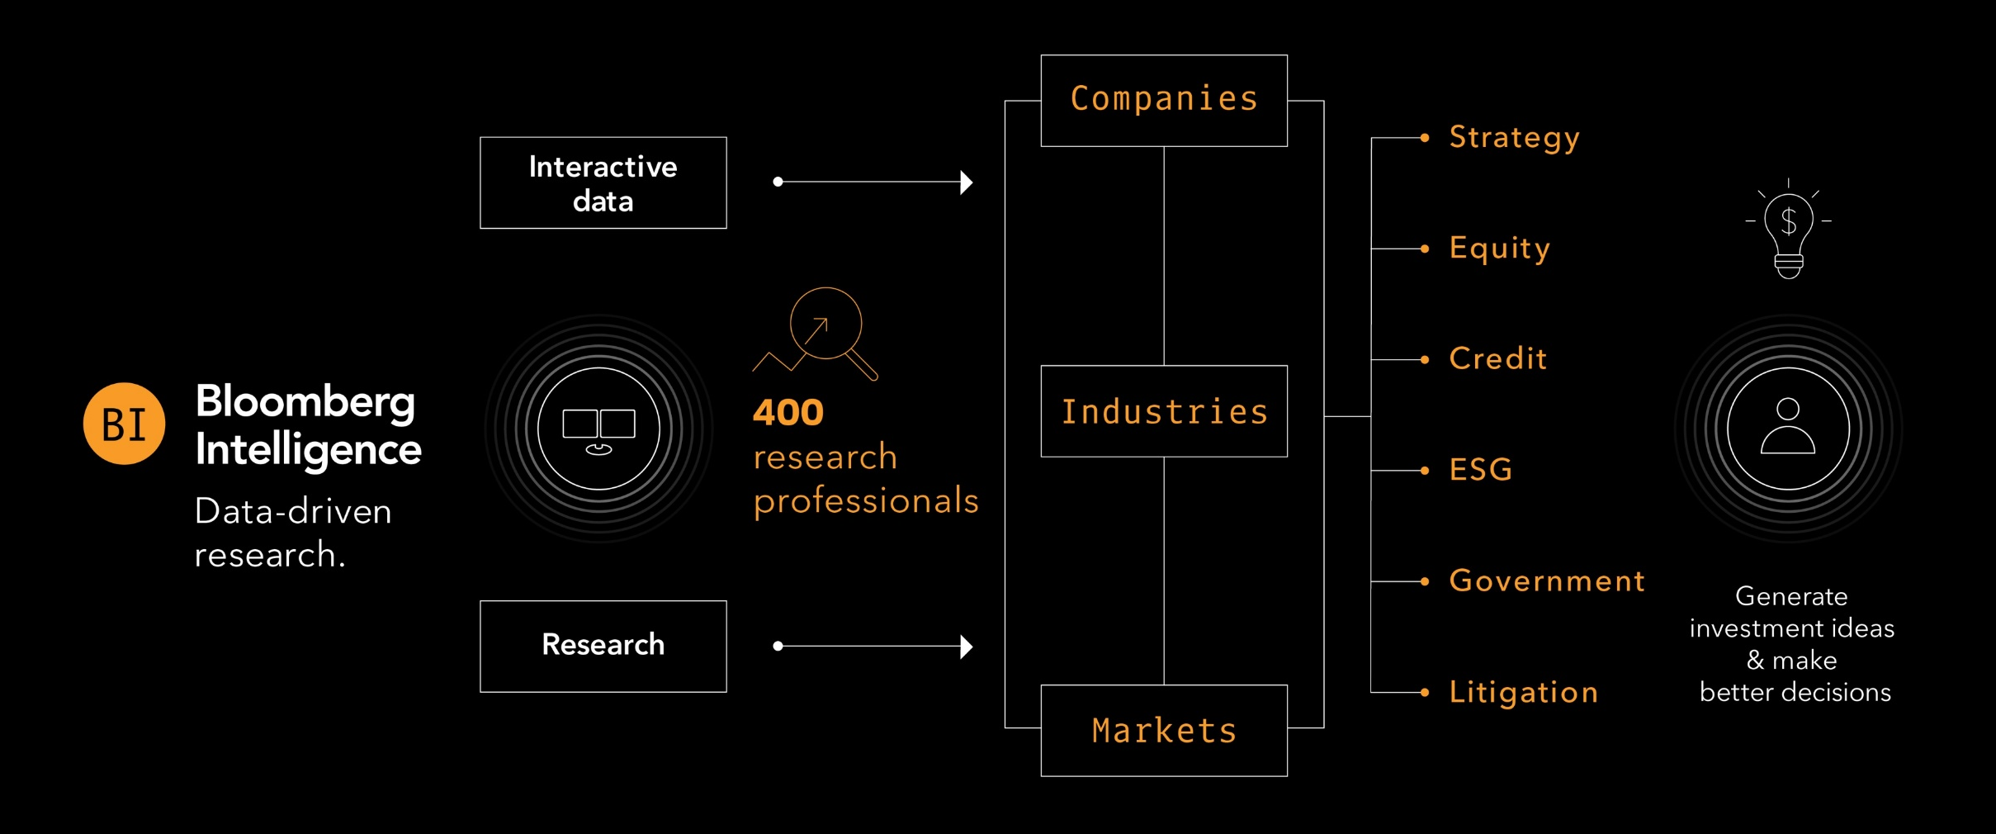
Bloomberg Intelligence
500+
data contributors
135+
industries
2,000+
companies
15yrs
avg. analyst experience
Bloomberg Intelligence (BI) research delivers an independent perspective providing interactive data and investment research on companies, industries and global markets. Our team of 400 research professionals help our clients make informed decisions in the rapidly moving investment landscape.

Slide 3
Topics
Explosion of M&A and Credit Implications
Relative Value Views

Slide 4
Explosion of M&A and Credit Implications
Stephen Flynn – Team Leader, Telecom and Media
Mike Holland – Sr. Credit Analyst, Healthcare
Arnold Kakuda - Sr. Credit Analyst, Financials
Mike Campellone - Credit Analyst, Retail
Mary Gilbert - Sr. Credit Analyst, Consumer
Jody Lurie - Sr. Credit Analyst, Consumer

Slide 5
Relative Value Views
Robert Schiffman – Team Leader, Technology
David Havens – Sr. Credit Analyst, Financials
Spencer Cutter - Sr. Credit Analyst, Energy
Himanshu Bakshi - Credit Analyst, Financials
Matt Geudtner - Credit Analyst, Industrials

Slide 6

Technology: Searching for Value
Robert Schiffman

Slide 7
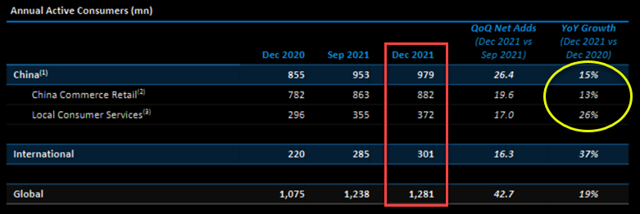
Technology: Alibaba

Slide 8
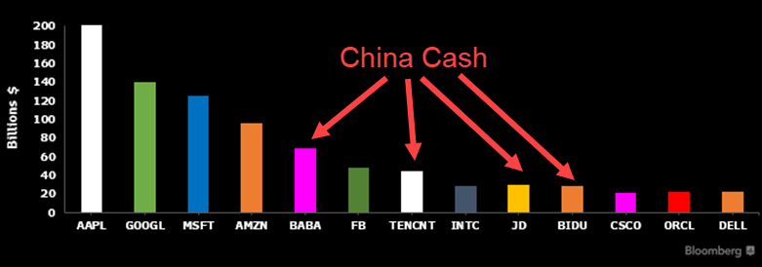
Technology: Alibaba

Slide 9
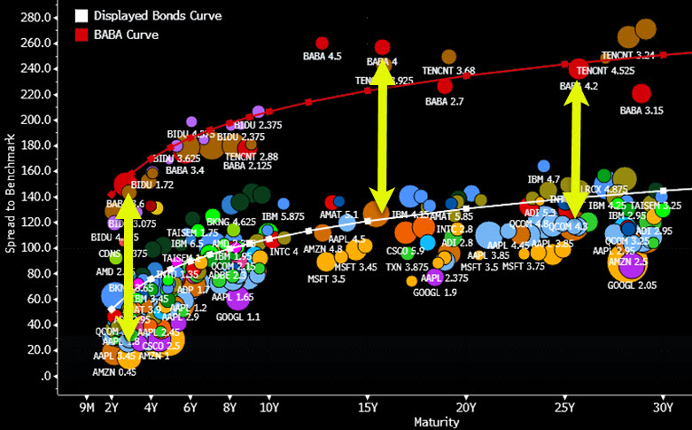
Technology: Alibaba

Slide 10
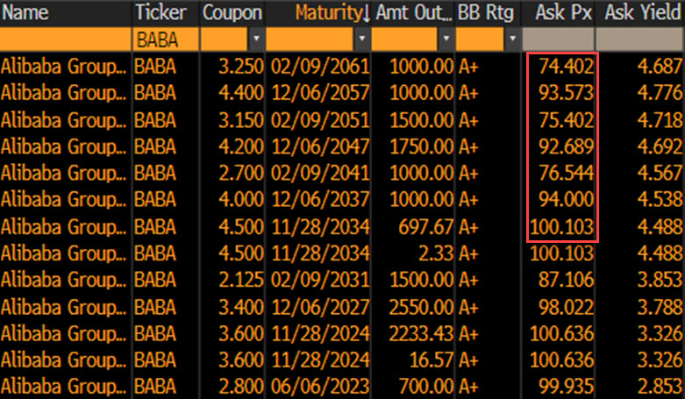
Technology: Alibaba
BBG0000GFZS9

Slide 11





Financials: Searching for Value
David Havens

Slide 12
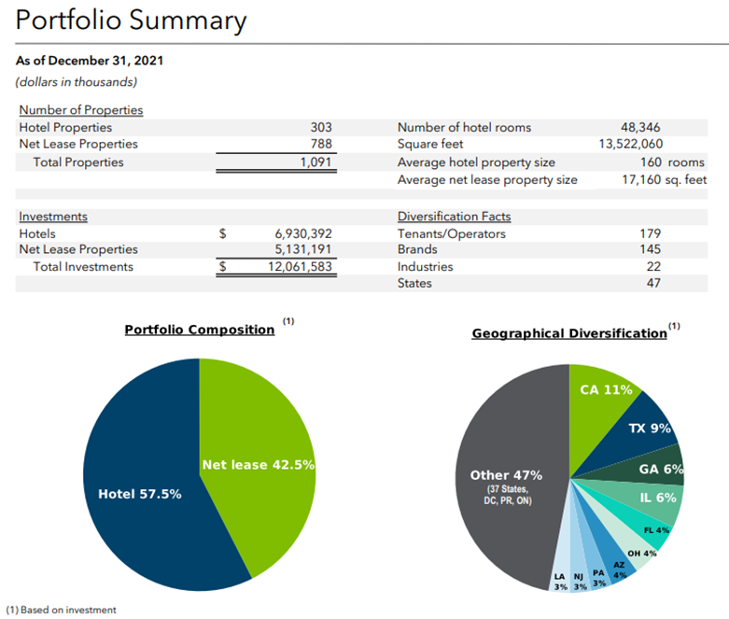
Financials: Service Properties Trust

Slide 13
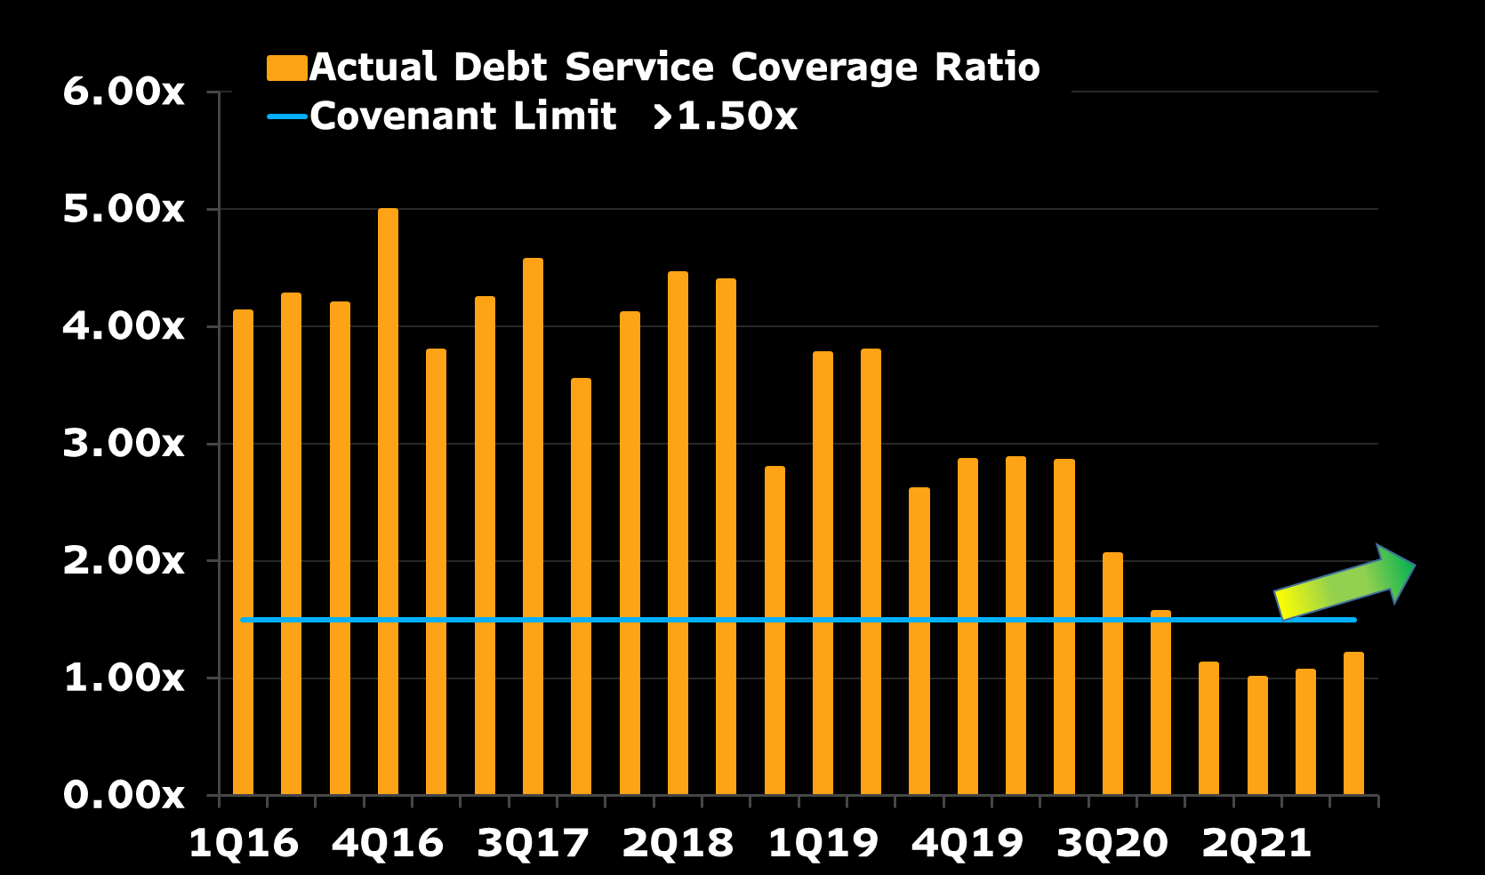

Financials: Service Properties Trust

Slide 14
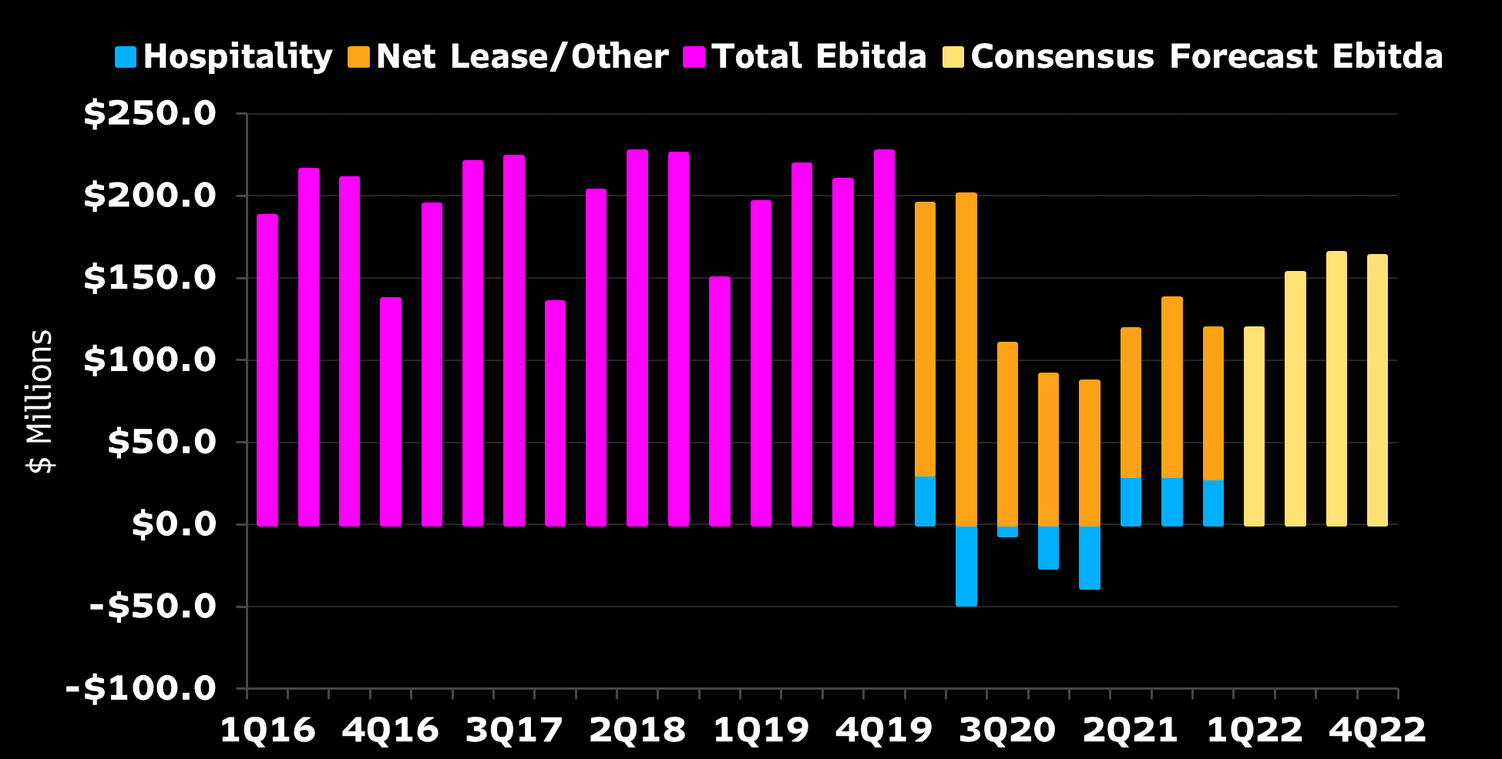
Financials: Service Properties Trust – Ebitdar Trends

Slide 15
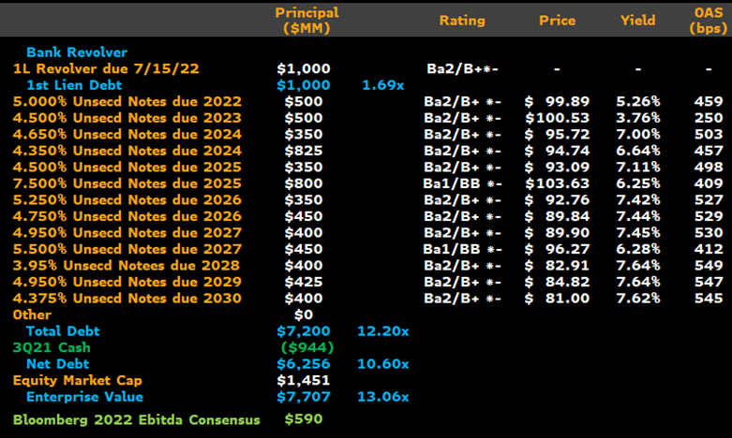
Financials: Service Properties Trust – YE21 Cap Table

Slide 16
FInancials: Service Properties Trust
“We continue to make progress on the previously announced sales of 68 Sonesta branded hotels. We have closed on two hotels for $28 million, one during Q4 2021 and one during Q1 2022. We are under purchase and sale agreement to sell 45 hotels for $402 million and our under letter of intent to sell an additional 19 hotels for $132 million. There are two hotels for which we have not yet selected a buyer.
Aggregate pricing for the hotels remains in line with expectations we discussed on our third quarter earnings call, and we expect to close the majority of these sales over the balance of Q1 and early Q2. We expect aggregate sale proceeds for the 66 hotels either sold or under agreement to total $560 million.”
BBG0000GFZS9
Todd Hargraves, Incoming President and current Chief Investment Officer of Service Properties Trust. Analyst Call February 25, 2022.

Slide 17
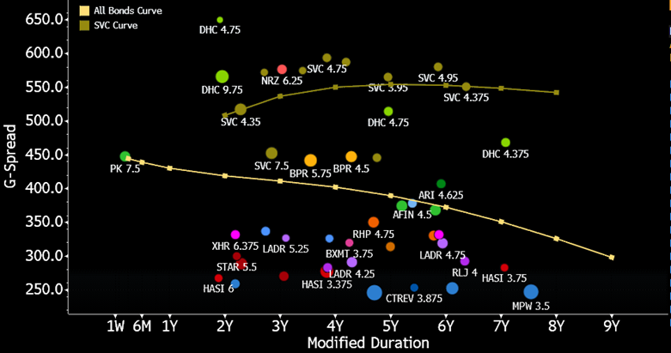
Financials: Service Properties Trust

Slide 18
Energy: $100 Oil May Not Lift All Boats
Spencer Cutter

Slide 19
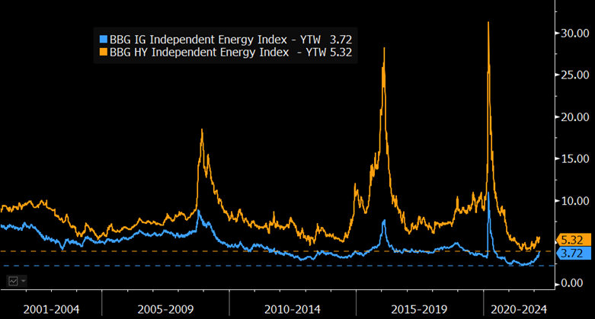
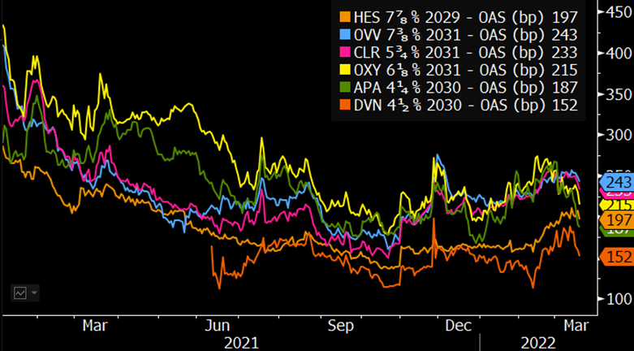
Independent Energy: Nowhere to Run
Source: Bloomberg

Slide 20
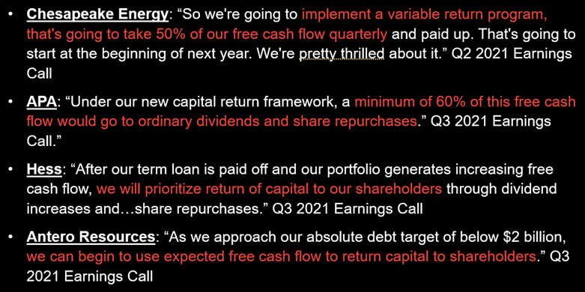
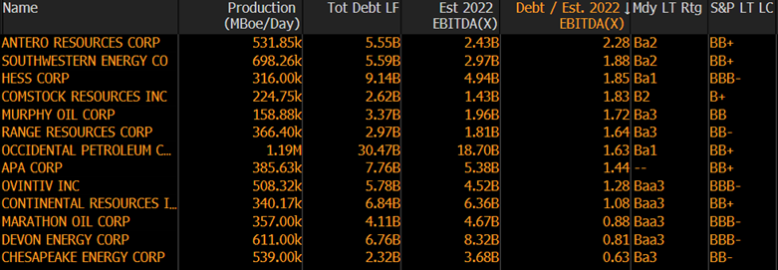
Independent Energy: Nowhere to Run
Source: Bloomberg

Slide 21
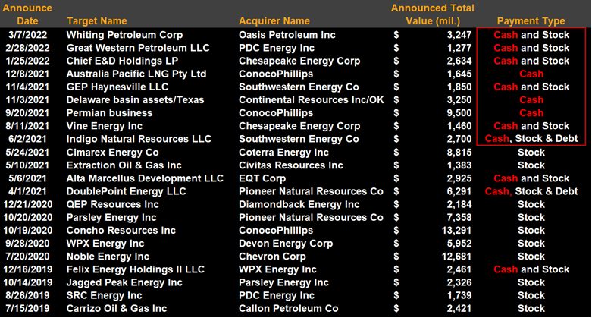
Independent Energy: M&A May Not Be Your Friend
Source: Bloomberg

Slide 22
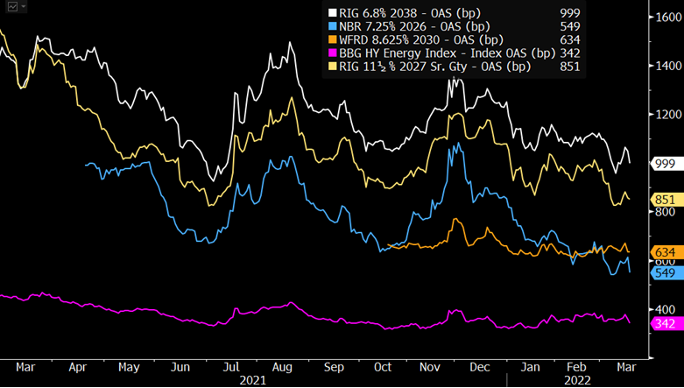
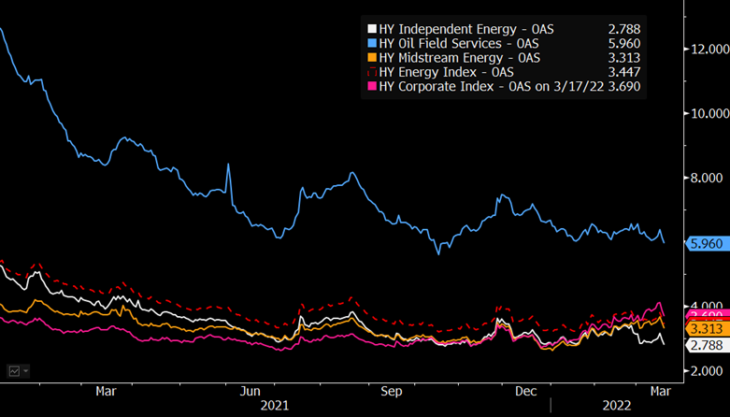
Energy: Healing Damaged Drillers
Source: Bloomberg

Slide 23
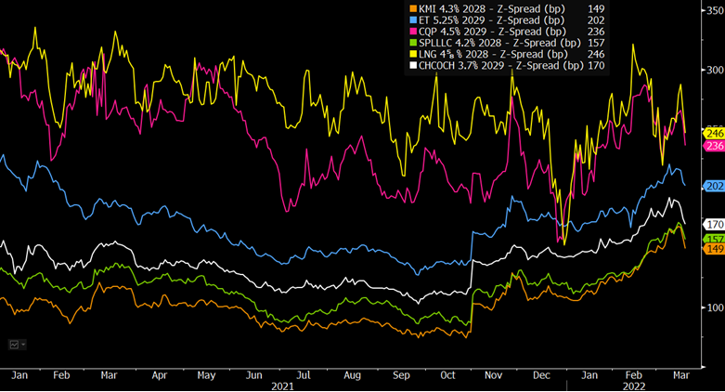
Energy: Structural Opportunities
Source: Bloomberg

Slide 24
Fintech: PayPal
Himanshu Bakshi

Slide 25
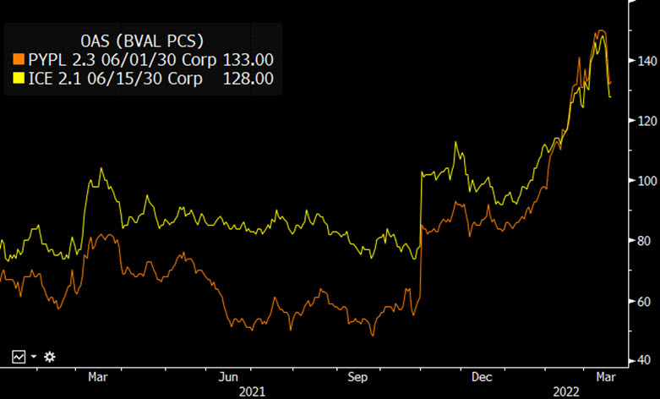
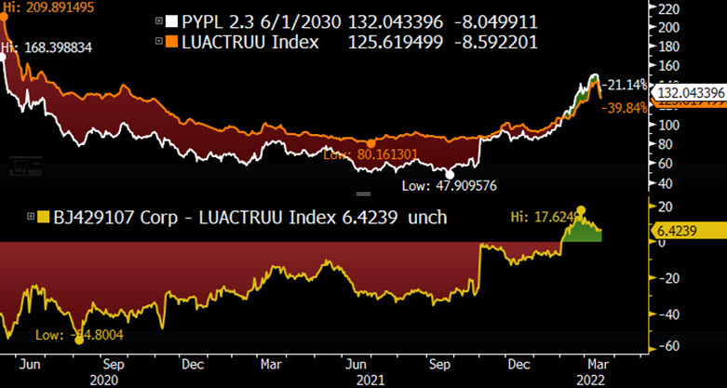
Fintech: PayPal
Source: Bloomberg

Slide 26
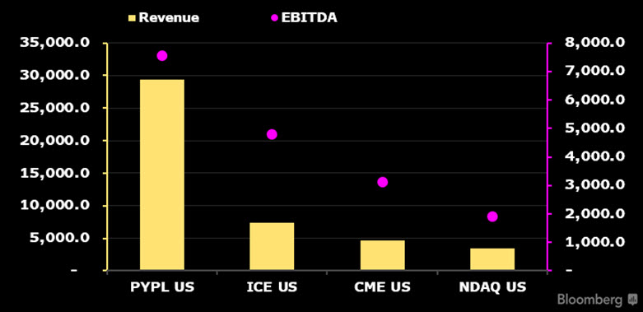
Fintech: PayPal
Source: Bloomberg

Slide 27
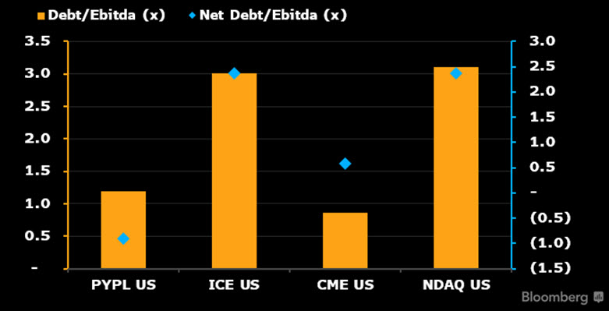
Fintech: PayPal
Source: Bloomberg

Slide 28
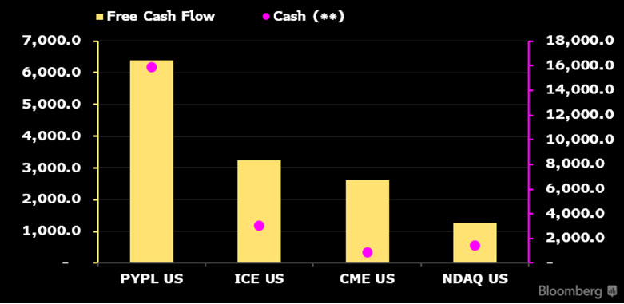
Fintech: PayPal
Source: Bloomberg

Slide 29
Industrials: Boeing
Matthew Geudtner

Slide 30
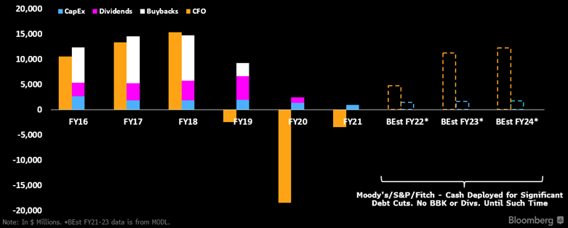
Industrials: Boeing
Source: Bloomberg

Slide 31
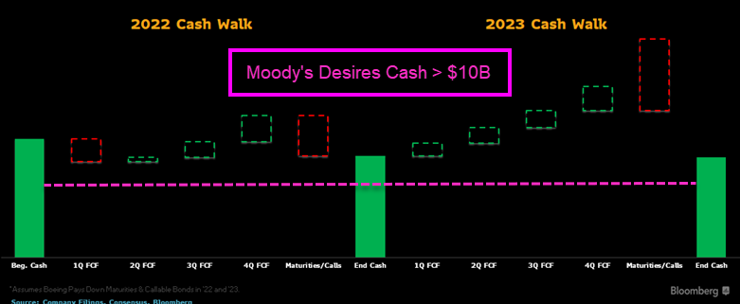
Industrials: Boeing
Source: Bloomberg

Slide 32
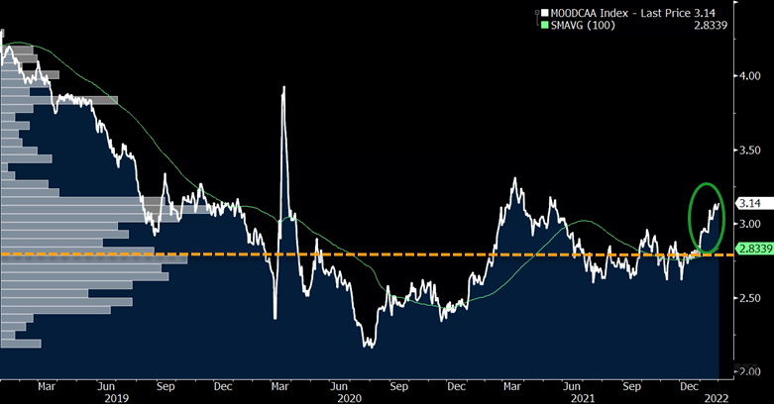
Industrials: Boeing
Source: Bloomberg

Slide 33
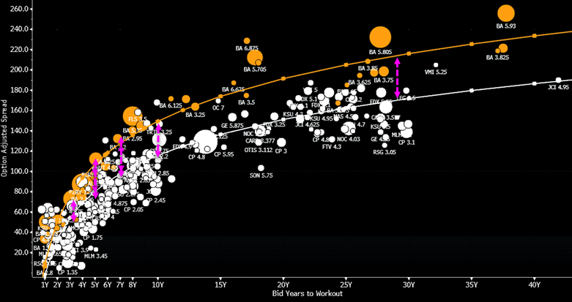
Industrials: Boeing
Source: Bloomberg

Slide 34
Q&A

Slide 35
Disclaimer
The data included in these materials are for illustrative purposes only. The BLOOMBERG TERMINAL service and Bloomberg data products (the “Services”) are owned and distributed by Bloomberg Finance L.P. (“BFLP”) except (i) in Argentina, Australia and certain jurisdictions in the Pacific Islands, Bermuda, China, India, Japan, Korea and New Zealand, where Bloomberg L.P. and its subsidiaries (“BLP”) distribute these products, and (ii) in Singapore and the jurisdictions serviced by Bloomberg’s Singapore office, where a subsidiary of BFLP distributes these products. BLP provides BFLP and its subsidiaries with global marketing and operational support and service. Certain features, functions, products and services are available only to sophisticated investors and only where permitted. BFLP, BLP and their affiliates do not guarantee the accuracy of prices or other information in the Services. Nothing in the Services shall constitute or be construed as an offering of financial instruments by BFLP, BLP or their affiliates, or as investment advice or recommendations by BFLP, BLP or their affiliates of an investment strategy or whether or not to “buy”, “sell” or “hold” an investment. Information available via the Services should not be considered as information sufficient upon which to base an investment decision. The following are trademarks and service marks of BFLP, a Delaware limited partnership, or its subsidiaries: BLOOMBERG, BLOOMBERG ANYWHERE, BLOOMBERG MARKETS, BLOOMBERG NEWS, BLOOMBERG PROFESSIONAL, BLOOMBERG TERMINAL and BLOOMBERG.COM. Absence of any trademark or service mark from this list does not waive Bloomberg’s intellectual property rights in that name, mark or logo. All rights reserved. © 2022 Bloomberg.
Bloomberg Intelligence is a service provided by Bloomberg Finance L.P. and its affiliates. Bloomberg Intelligence likewise shall not constitute, nor be construed as, investment advice or investment recommendations, or as information sufficient upon which to base an investment decision. The Bloomberg Intelligence function, and the information provided by Bloomberg Intelligence, is impersonal and is not based on the consideration of any customer's individual circumstances. You should determine on your own whether you agree with Bloomberg Intelligence.
Bloomberg Intelligence Credit and Company research is offered only in certain jurisdictions. Bloomberg Intelligence should not be construed as tax or accounting advice or as a service designed to facilitate any Bloomberg Intelligence subscriber's compliance with its tax, accounting, or other legal obligations. Employees involved in Bloomberg Intelligence may hold positions in the securities analyzed or discussed on Bloomberg Intelligence.

Slide 36
Disclaimer
The data included in these materials are for illustrative purposes only. The BLOOMBERG TERMINAL service and Bloomberg data products (the “Services”) are owned and distributed by Bloomberg Finance L.P. (“BFLP”) except (i) in Argentina, Australia and certain jurisdictions in the Pacific Islands, Bermuda, China, India, Japan, Korea and New Zealand, where Bloomberg L.P. and its subsidiaries (“BLP”) distribute these products, and (ii) in Singapore and the jurisdictions serviced by Bloomberg’s Singapore office, where a subsidiary of BFLP distributes these products. BLP provides BFLP and its subsidiaries with global marketing and operational support and service. Certain features, functions, products and services are available only to sophisticated investors and only where permitted. BFLP, BLP and their affiliates do not guarantee the accuracy of prices or other information in the Services. Nothing in the Services shall constitute or be construed as an offering of financial instruments by BFLP, BLP or their affiliates, or as investment advice or recommendations by BFLP, BLP or their affiliates of an investment strategy or whether or not to “buy”, “sell” or “hold” an investment. Information available via the Services should not be considered as information sufficient upon which to base an investment decision. The following are trademarks and service marks of BFLP, a Delaware limited partnership, or its subsidiaries: BLOOMBERG, BLOOMBERG ANYWHERE, BLOOMBERG MARKETS, BLOOMBERG NEWS, BLOOMBERG PROFESSIONAL, BLOOMBERG TERMINAL and BLOOMBERG.COM. Absence of any trademark or service mark from this list does not waive Bloomberg’s intellectual property rights in that name, mark or logo. All rights reserved. © 2022 Bloomberg.
Bloomberg Intelligence is a service provided by Bloomberg Finance L.P. and its affiliates. Bloomberg Intelligence likewise shall not constitute, nor be construed as, investment advice or investment recommendations, or as information sufficient upon which to base an investment decision. The Bloomberg Intelligence function, and the information provided by Bloomberg Intelligence, is impersonal and is not based on the consideration of any customer's individual circumstances. You should determine on your own whether you agree with Bloomberg Intelligence.
Bloomberg Intelligence Credit and Company research is offered only in certain jurisdictions. Bloomberg Intelligence should not be construed as tax or accounting advice or as a service designed to facilitate any Bloomberg Intelligence subscriber's compliance with its tax, accounting, or other legal obligations. Employees involved in Bloomberg Intelligence may hold positions in the securities analyzed or discussed on Bloomberg Intelligence.

