Slide 1
Shattering Shibboleths
Almost Everything We Know About High Yield Bonds Is Wrong
Martin Fridson, CFA
Chief Investment Officer
Lehmann Livian Fridson Advisors LLC
Presented to Fixed Income Analysts Society, Inc.
September 21, 2021

Slide 2
What Is the Best Financial Ratio
For High Yield Analysis?

Slide 3
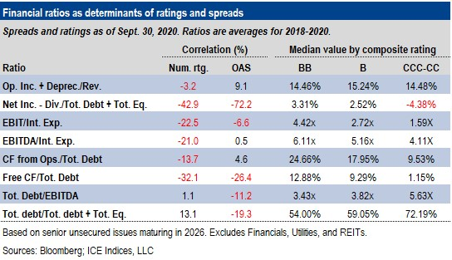
It’s Not Coverage, Leverage, or FCF

Slide 4
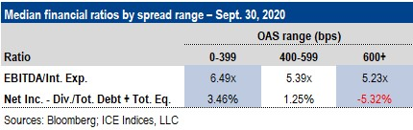
Testing Ratios’ Power to Discriminate

Slide 5
Spread Tightening Overstated

Slide 6
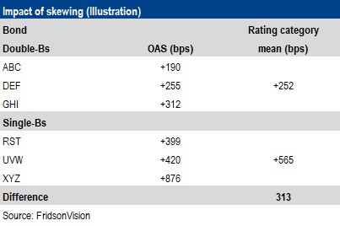
Here’s Just One Source of Distortion

Slide 7
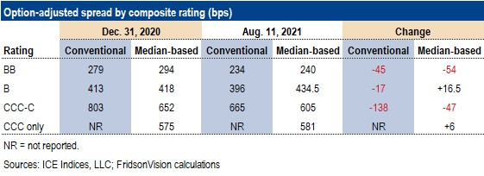
Exaggerated Spread Tightening

Slide 8
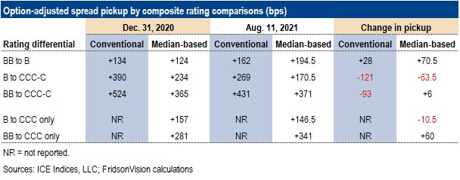
Change in Risk-Reward Was Overstated

Slide 9
High Yield Busted Converts Are Not
Systematically Undervalued

Slide 10
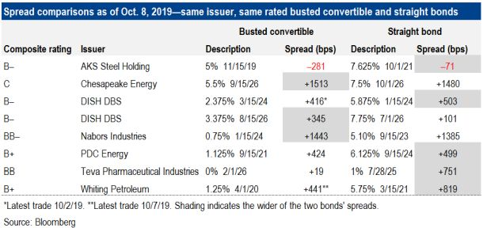
No Consistent Pattern

Slide 11
Market-Weighted Index Does Not Force Investors into Most Leveraged Issuers

Slide 12

Lots of Debt ≠ High Leverage

Slide 13
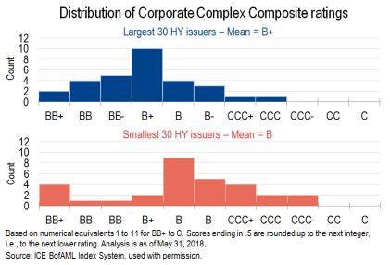
Bigger Debtors Are LESS Leveraged

Slide 14
Quality Decline in Issuance Boom Does Not Cause Subsequent Default Rate Surge

Slide 15
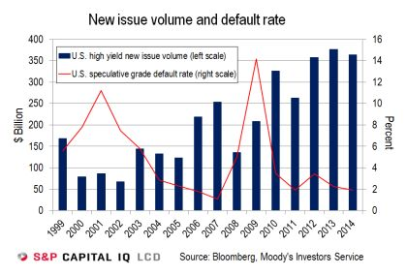
Post Hoc Ergo Propter Hoc

Slide 16
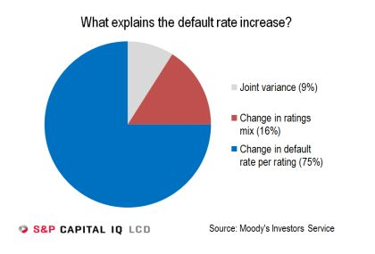
Why Default Rates Actually Rise

Slide 17
Bond Prices Fall When Yields Decline
(Sometimes)

Slide 18
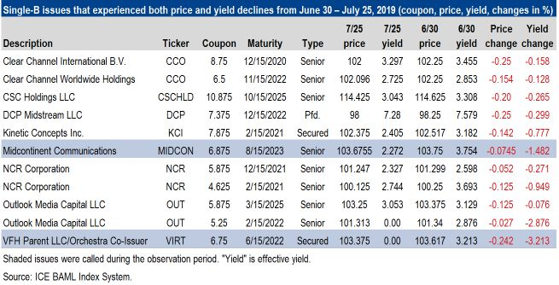
You Can Look It Up!

Slide 19
HY Spread Curve: Positive or Negative?
Neither!

Slide 20
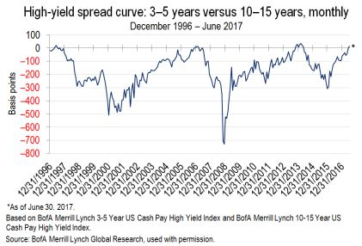
It’s Dangerous to Generalize

Slide 21
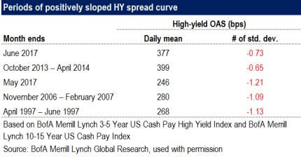
High Risk Tolerance Turns Spread Curve Positive

Slide 22
High Yield Prices Are Wrong
Without a Doubt

Slide 23
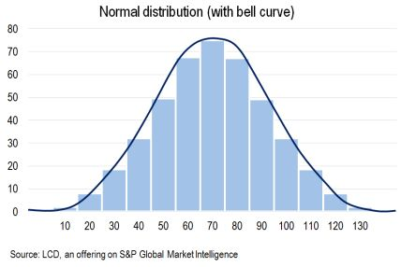
Here’s What the Record
Ought To Show

Slide 24
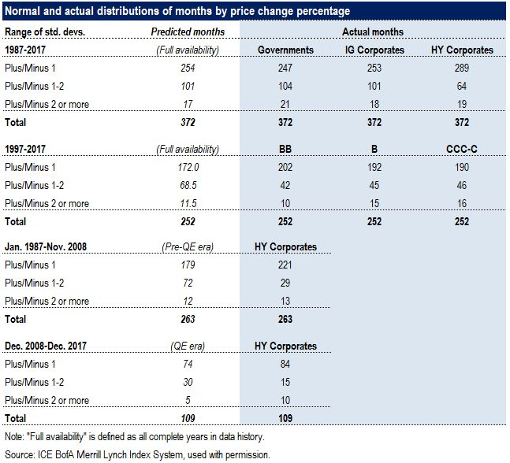
Many Middle-Range Months Are Missing

Slide 25
Thanks for Watching!
For information about Martin Fridson’s high yield research:
marty@fridson.com

