Slide 1
BI Credit & Strategy - FIASI
January 14, 2021

Slide 3
Today’s Agenda
BI Credit: Analyst Roundtable - Terminal Tools That Can Make Your Job Easier
BI FICC Strategy: Outlook for Credit and Rates
BI Credit: Analyst Roundtables – Ideas for 2021
Notes:
Here’s the agenda but really I hope it’s an open 2-way dialogue - please do feel free to ask us questions. Steve is going to start by taking us through BI Credit and how to access the tools and research. I’ll come back and walk through a few of the Excel tools that we’ve created. And then Rob will discuss our methodology as well as our most recent ‘wide and tight’ bond lists. So Steve, let me pass the mike over to you.

Slide 4

Roundtable - Functionality
Presenters:
Mike Campellone – CAST/DDIS
Himanshu Bakshi - SRCH
Matt Geudtner - FIW
Arnold Kakuda – IN/PORT
Joel Levington – MA/BUYP

Slide 5
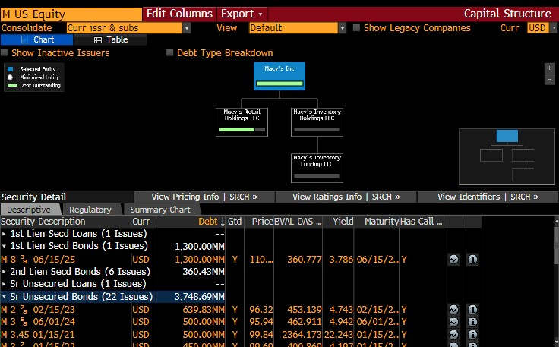
Capital Structure – CAST

Slide 6
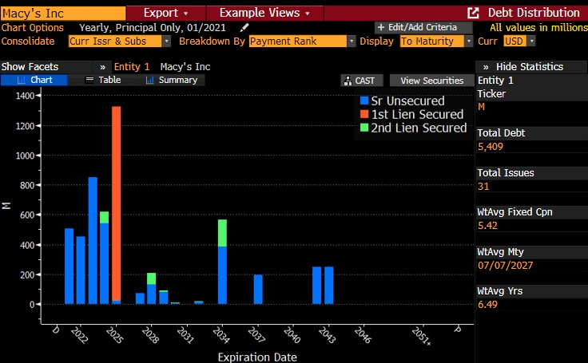
Debt Distribution – DDIS

Slide 7
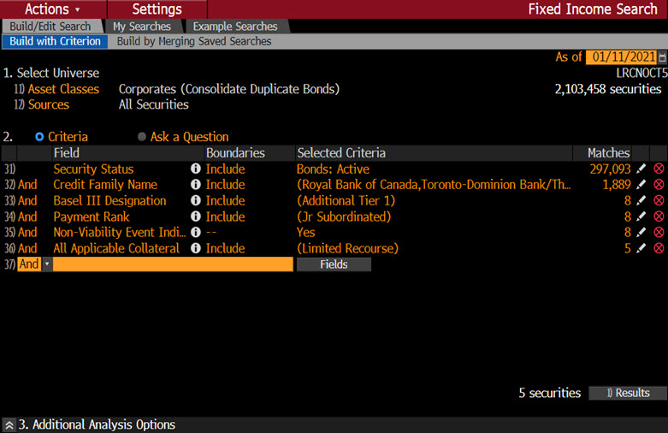
Bond Search – SRCH

Slide 8
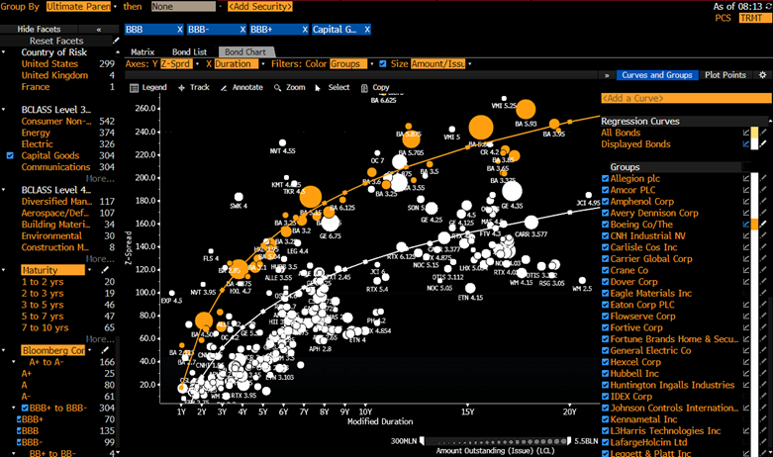
Fixed Income Worksheet – FIW

Slide 9
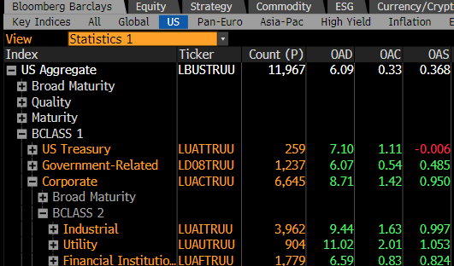
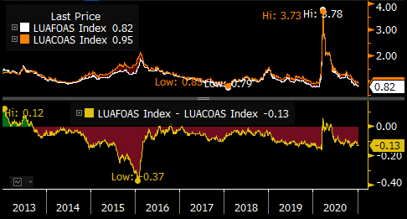
Bloomberg Index Browser – IN

Slide 10
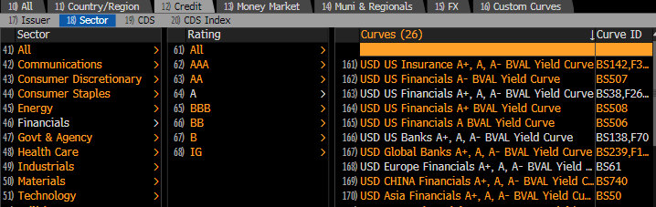

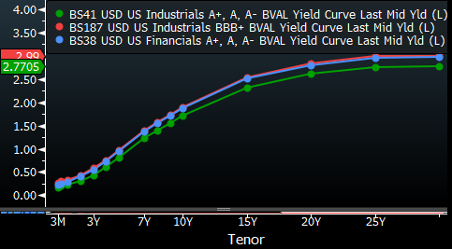
Curve Finder – CRVF

Slide 11
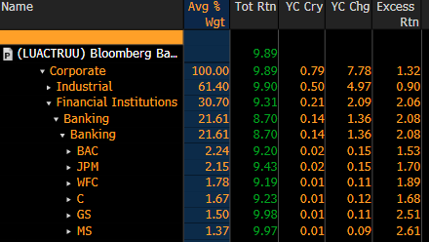
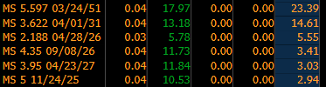
Portfolio Analytics – PORT

Slide 12
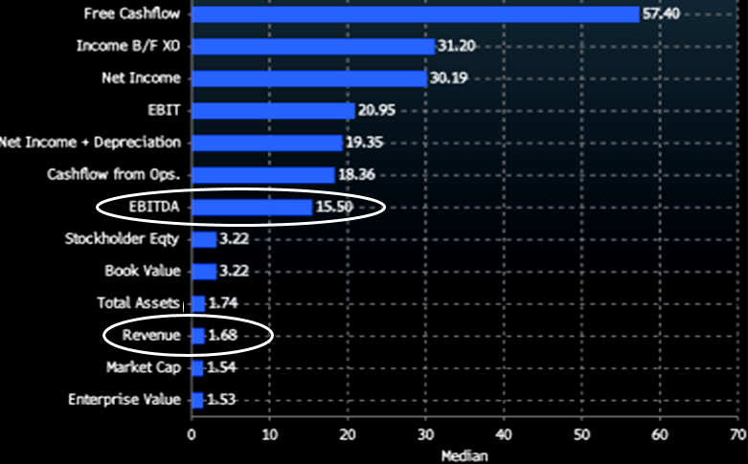
M&A Analysis With Functions – MA and BUYP
Notes:
Since I got the last pick in the function draft, and I’m the boss, I cheated a little and decided to go with two functions – MA and BUYP. Really, these are complementary tools that can give clients a tremendous amount of information in a short period of time. Above is just a small sample of what the MA function generates for clients.
One of the first questions clients ping me on when a deal is announced is “is the deal pricey or cheap”? Of course, more recently, with low cost funding for everyone, cheap has rarely been a response. With the MA function, I can quickly see what multiples a company has paid (or expanded more broadly, what is the average multiple paid for a sector over a given period of time). In this case, Danaher, and industrial that has evolved from a industrial tool and heavy-duty truck brake manufacturer into a diversified healthcare and environmental business, has paid about 15.5x Ebitda for acquisitions. I can also find that 43% of the company’s deals have been paid for in cash, with 73% of deals $500 million or less in size.
Using BUYP as a complementary tool, I can better find out if I should get comfortable with Danaher making what I would call tuck-in acquisitions or not….

Slide 13
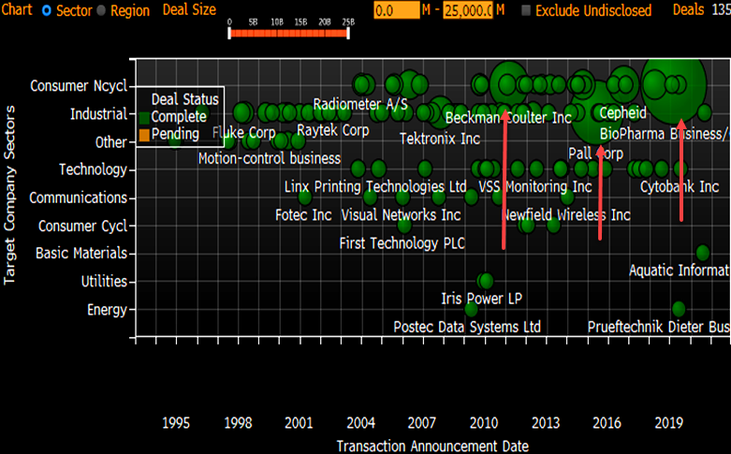
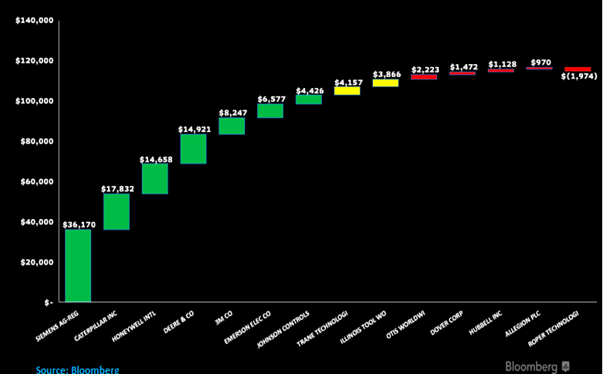
M&A Analysis - BUYP
Notes:
Not sure if I mentioned, but Danaher is a serial acquirer, and as you can see, it never stops chomping! The BUYP function tells me the company has made 135 deals in its history. Note that the size of the green bubbles indicates the size of the deals the company has made. You can see that through 2010, the bolt-on strategy for deal-making was common. But then in 2011, Danaher purchased Beckman Coulter for $7 billion, and it recognized it could manage larger deals from a management perspective. It also recognized that it didn’t need to have such low leverage and an A-tier rating, as it held for years under Larry Culp – now the Chairman of GE. So BUYP clearly shows a strategy shift towards larger deals – a cycle of leverage to delever and then buy the next asset, has begun. Something to consider later this year as the company’s balance sheet is well positioned for its next M&A bite.
As luck would have it, early at BI the team created a debt capacity model, that is a perfect complement to the MA and BUYP data. It also happens to be an Excel that any client can download and utilize for free! So we can take Danaher’s historic multiples of 15.5x Ebitda, its leverage goals of 3-4x leverage, and 2021 consensus – or your own estimates, do determine how much financial flexibility it has to stay within its BBB+ rating bands. Our Excel tool can be used for single-name work, or as shown on the right, a peer comparison - in this case, for high grade industrials.

Slide 14


US Rates and Corporate Credit Outlook
Ira Jersey
Bloomberg Intelligence
Chief US Interest Rate Strategist
+1-609-279-3564
ijersey5@bloomberg.net
Noel Hebert
Bloomberg Intelligence
Chief US Credit Strategist
+1-609-279-5057
nhebert5@bloomberg.net

Slide 15
US Rates Outlook

Slide 16
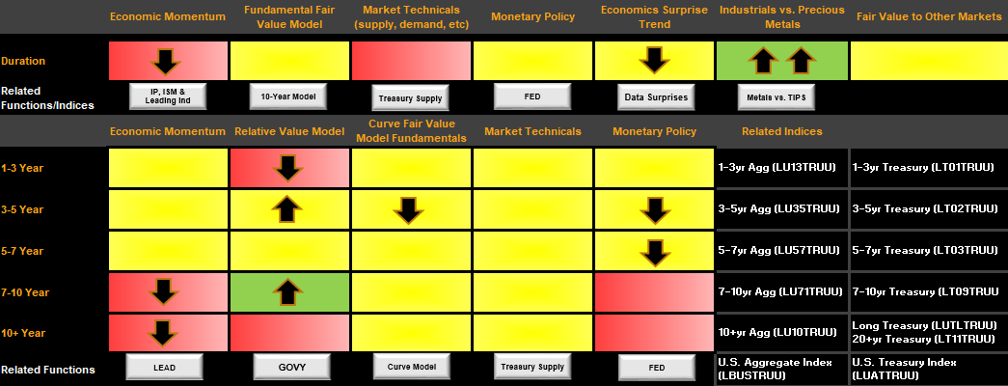
U.S. Yield Tactical Scorecard
Source: Bloomberg Intelligence

Slide 17
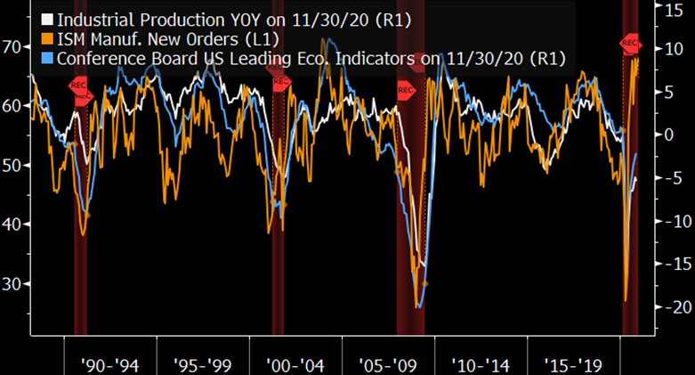
Economic Momentum Trending Up
Source: Bloomberg Intelligence, G #BI 14042

Slide 18
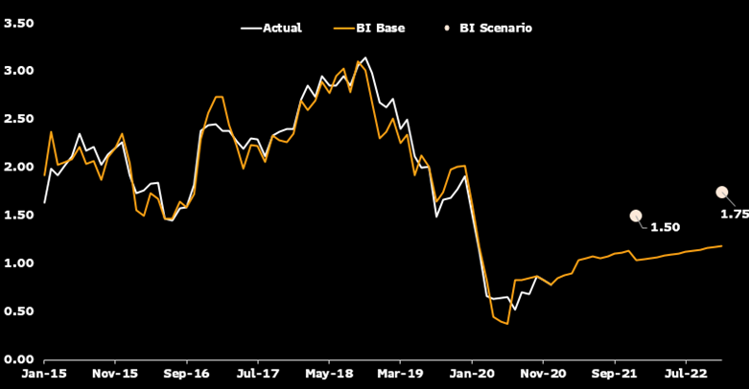
10-year Treasury Yield Model
Source: Bloomberg Intelligence

Slide 19
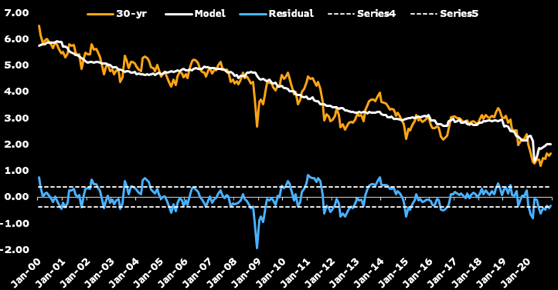
30-year Treasury Yield Model
Source: Bloomberg Intelligence

Slide 20
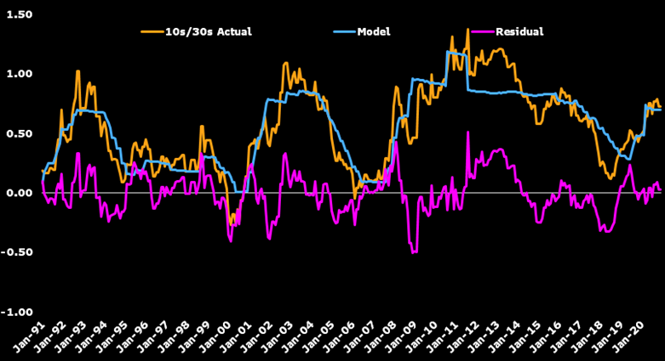
10-year/30-year Yield Curve Model
Source: Bloomberg Intelligence

Slide 21
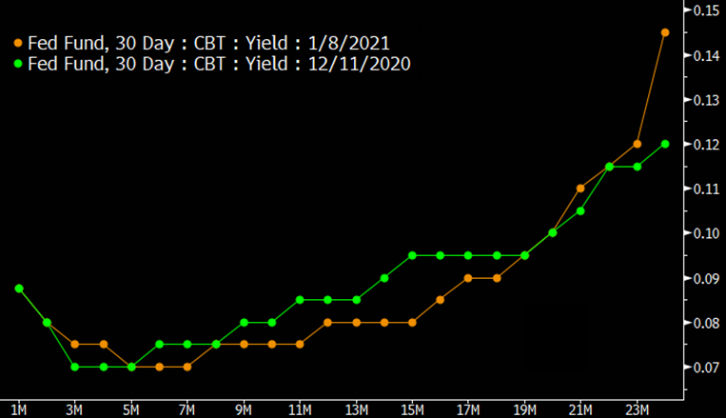
Market Not Expecting Hikes for Ages (CCRV of FF)
Source: Bloomberg Intelligence

Slide 22
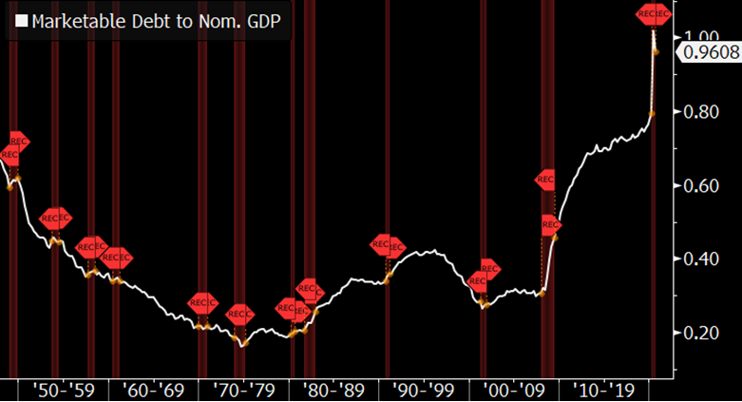
Marketable Debt Continues Climbing
Source: Bloomberg Intelligence, G #BI 103888

Slide 23
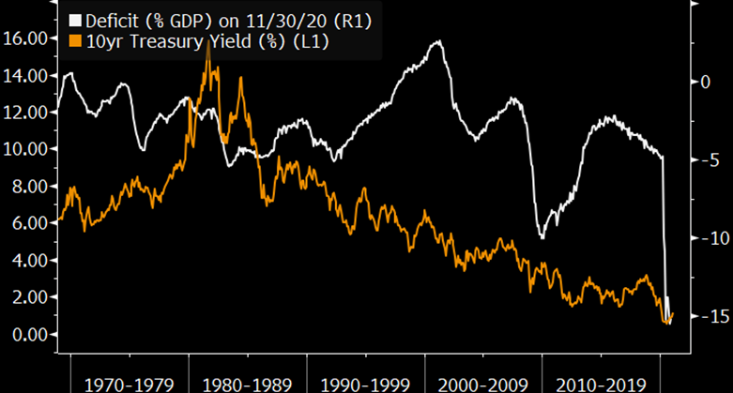
Deficits Have Little Correlation to Yields
Source: Bloomberg Intelligence, G #BI 11550

Slide 24
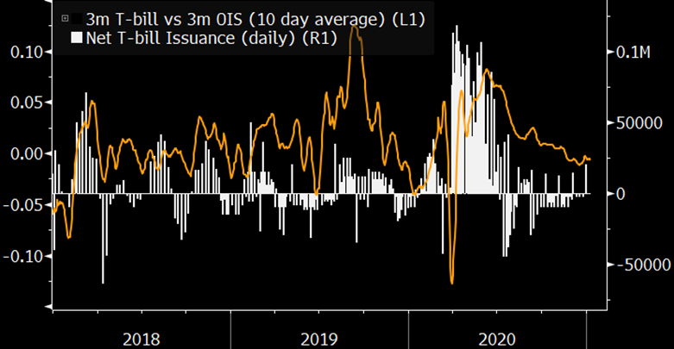
Net Treasury Bill Issuance vs. T-bill/OIS Spread
Source: Bloomberg Intelligence, G #BI 17029

Slide 25
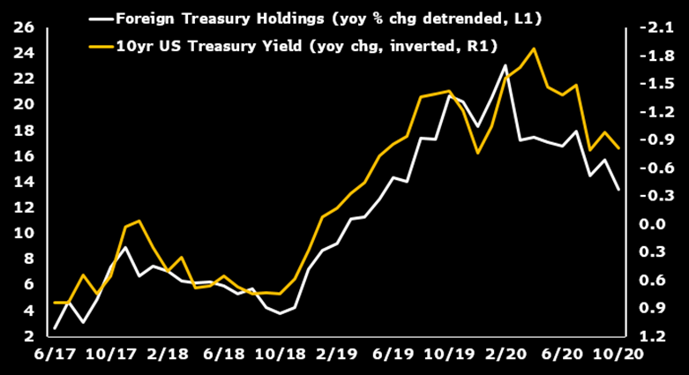
Overseas Demand Important for Treasury Pricing
Source: Bloomberg Intelligence

Slide 26
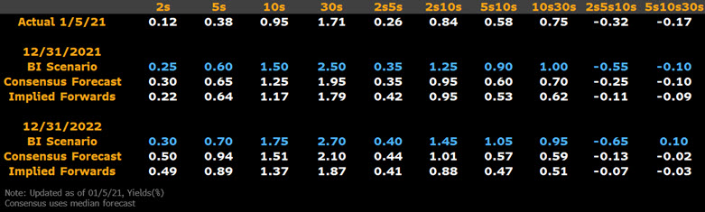
BI Scenarios - More Bear Steepening than Consensus
Source: Bloomberg Intelligence

Slide 27
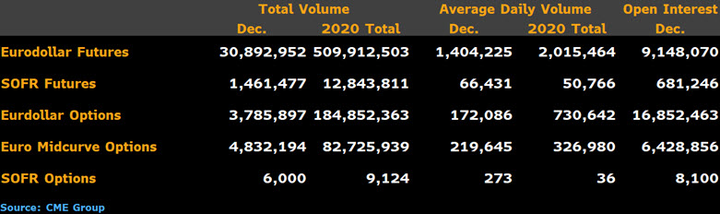
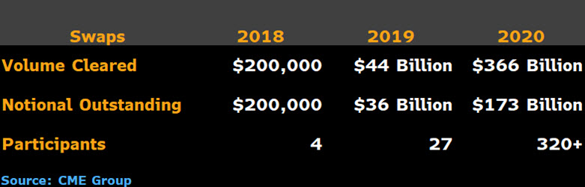
SOFR Volumes Behind Libor, but Big Change Soon
Source: CME Group

Slide 28
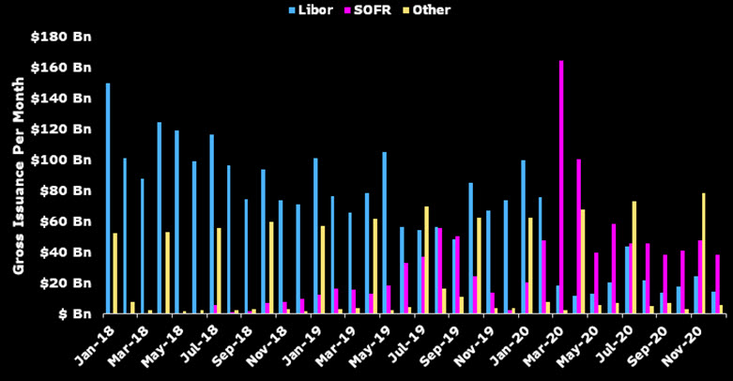
SOFR Primary New Cash Bond Reference Rate
Source: Bloomberg Intelligence, Bloomberg

Slide 29
US Corporate Credit Outlook

Slide 30
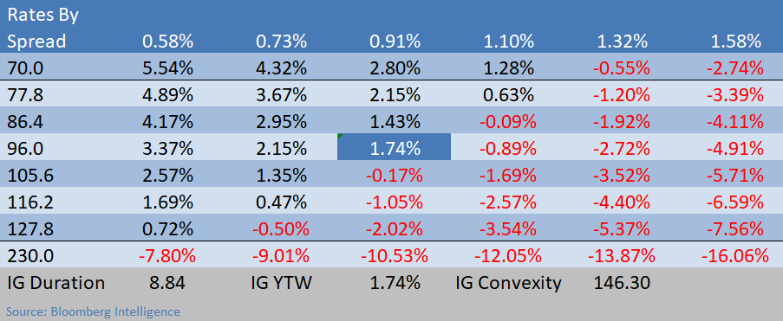
Total Return: U.S. IG (as of Dec. 31)
Source: Bloomberg Intelligence

Slide 31
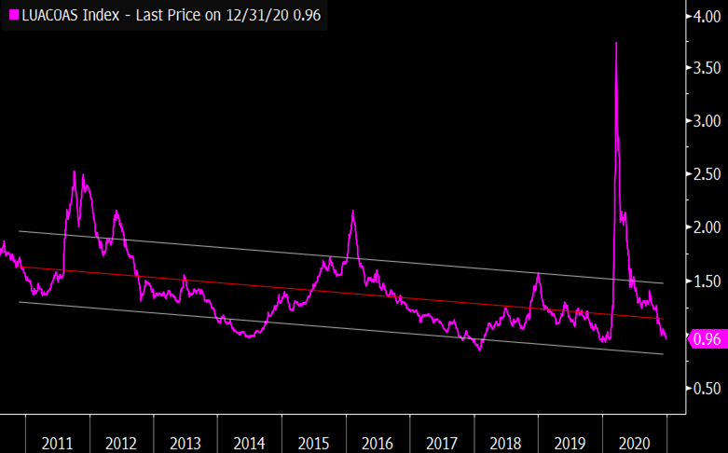
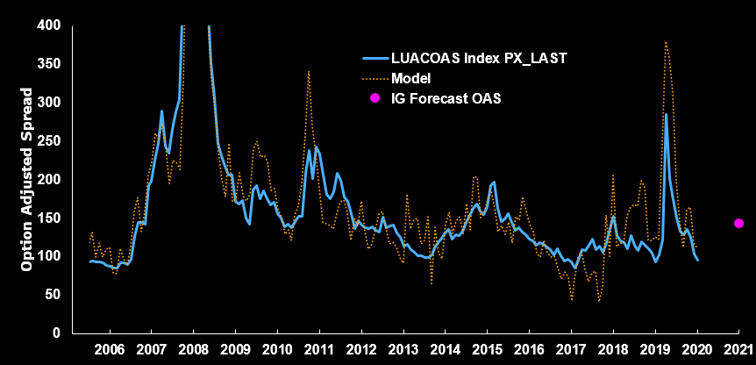
Option Adjusted Spread: U.S. IG (as of Dec. 31)
Source: Bloomberg Intelligence

Slide 32
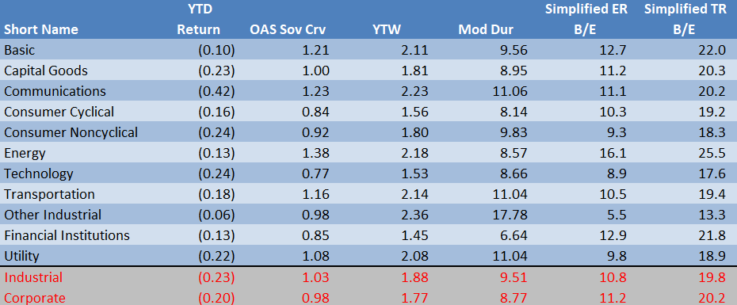
Compensation, Duration Adjusted: U.S. IG (as of Jan. 4)
Source: Bloomberg Intelligence

Slide 33
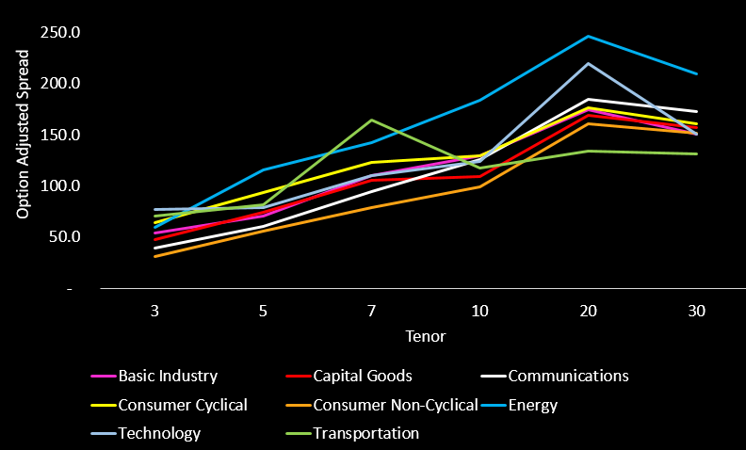
BBB Sector Curves: U.S. IG (as of Jan. 11)
Source: Bloomberg Intelligence

Slide 34
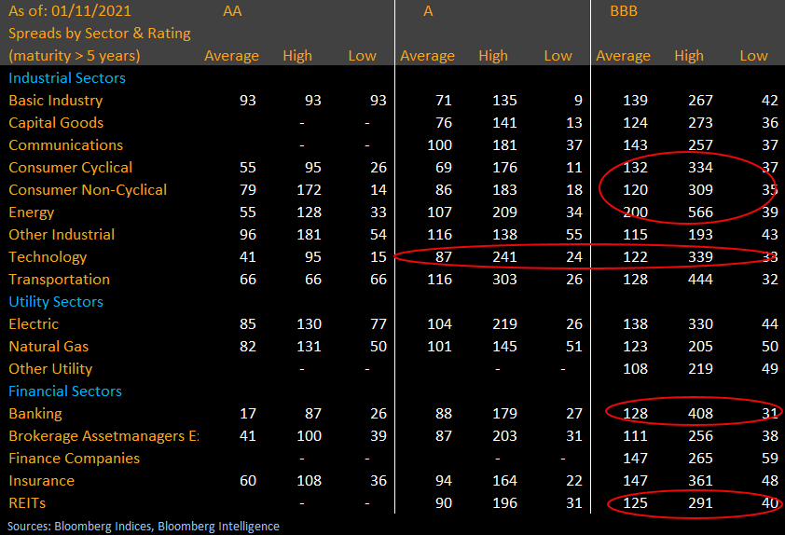
Spread Distribution by Rating: U.S. IG (as of Jan. 11)

Slide 35
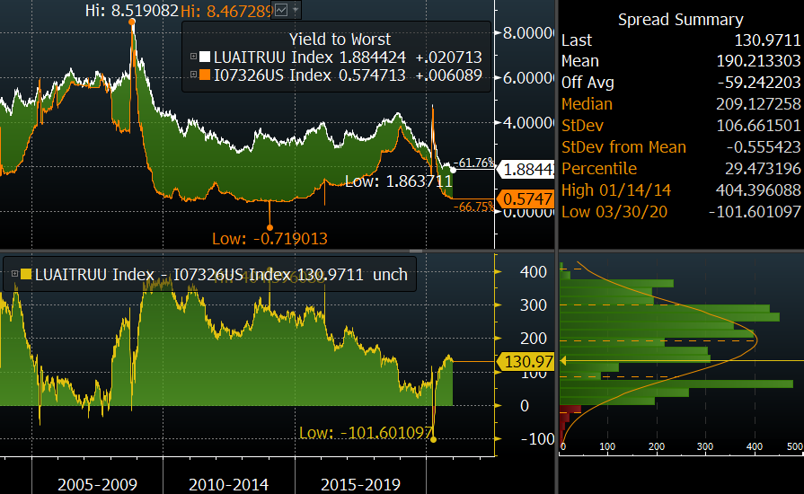
FRN Advantage Shrinks: U.S. IG (G #BI 105685)
Source: Bloomberg Intelligence

Slide 36
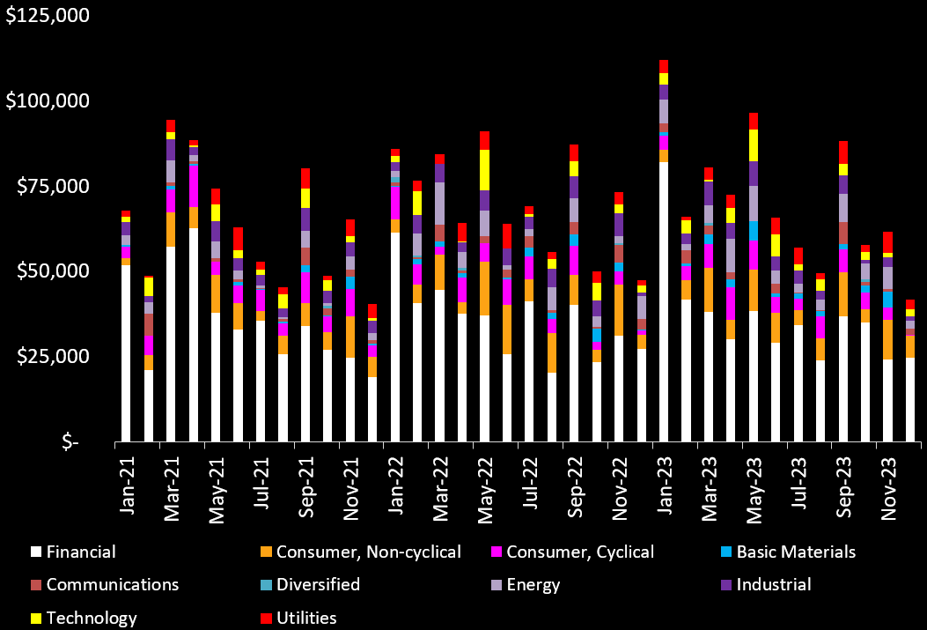
New Issuance, Monthly Maturities: U.S. IG
Source: Bloomberg Intelligence

Slide 37
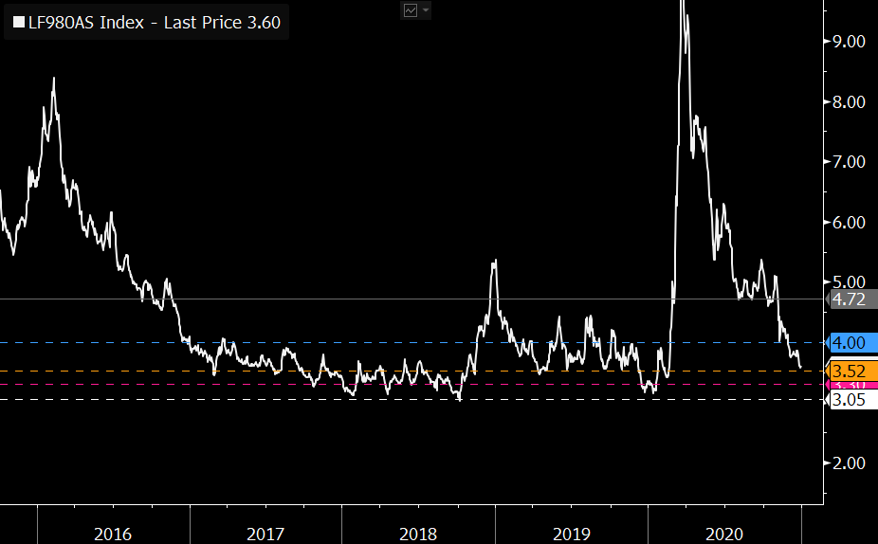
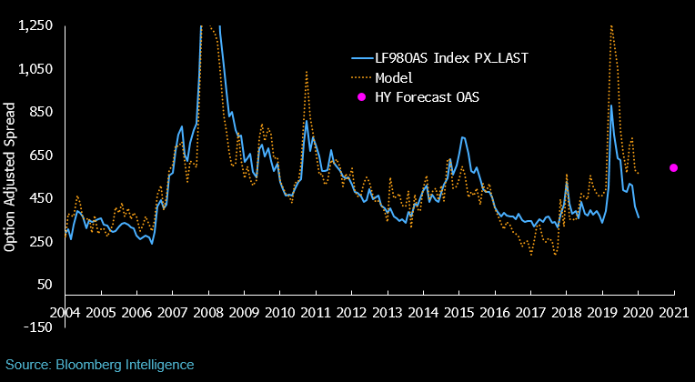
Option Adjusted Spread: U.S. HY (as of Dec. 31)
G #BI 102857

Slide 38
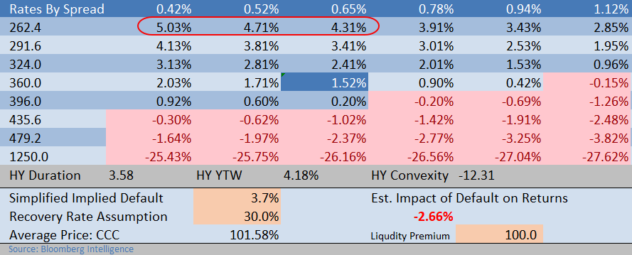
Total Return: U.S. HY (as of Dec. 31)

Slide 39
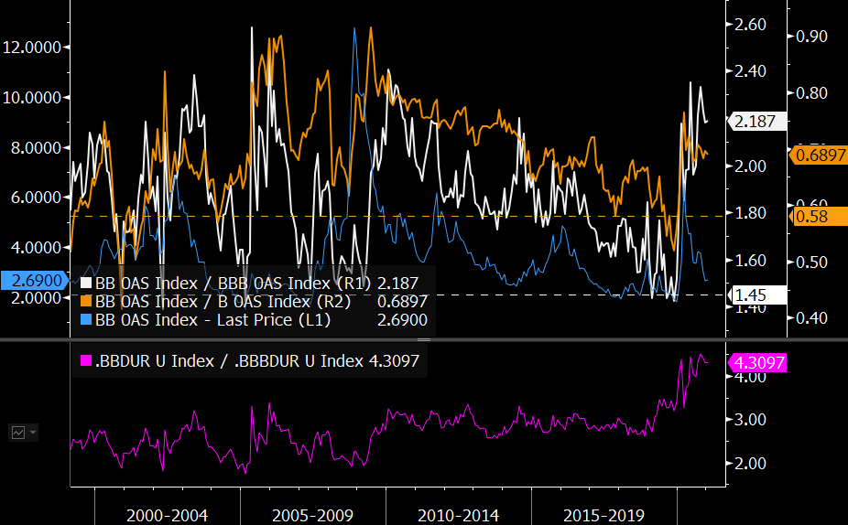
BBs Still Best Positioned: U.S. HY (as of Jan. 4, G #BI 19514)
Source: Bloomberg Intelligence

Slide 40
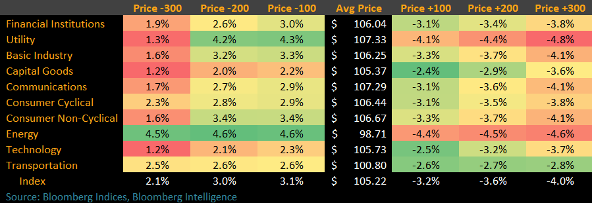
Price Sensitivity to Yield Change: U.S. HY (as of Jan. 5)

Slide 41
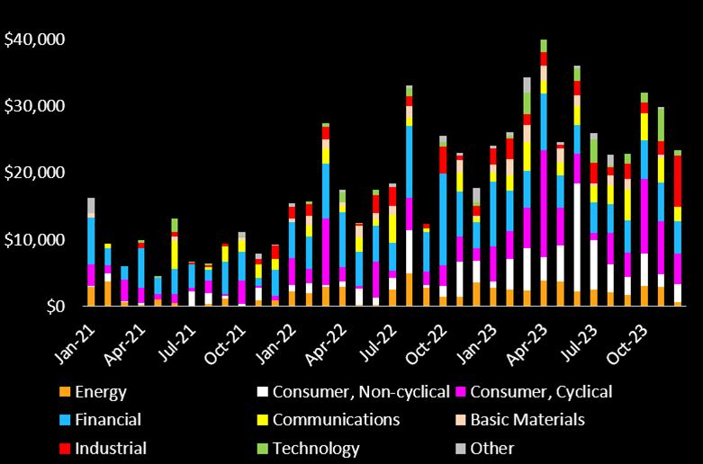
New Issuance, Monthly Maturities: U.S. HY
Source: Bloomberg Intelligence

Slide 42
Analyst Roundtable: Ideas for 2021

Slide 43
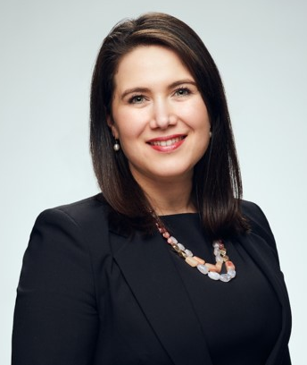
Travel, Leisure, Lodging, & Gaming
Jody Lurie
Bloomberg Intelligence
Senior Credit Analyst
+1-212-617-2754
jlurie20@bloomberg.net

Slide 44
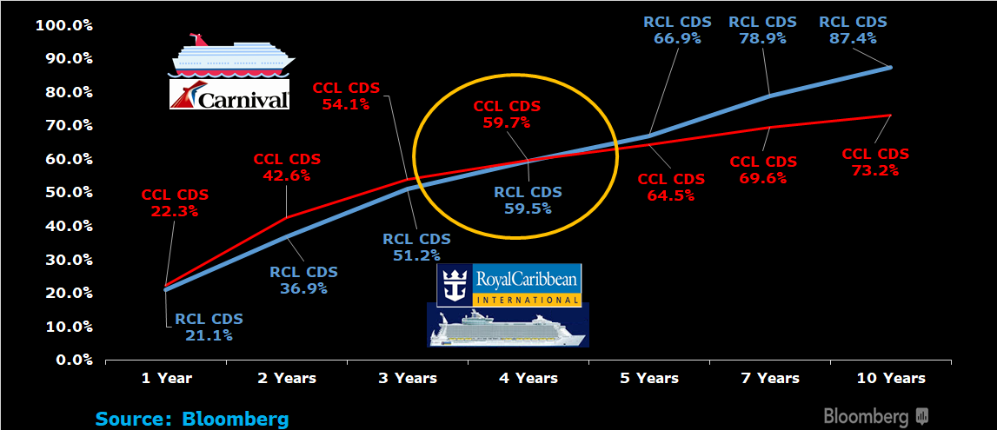
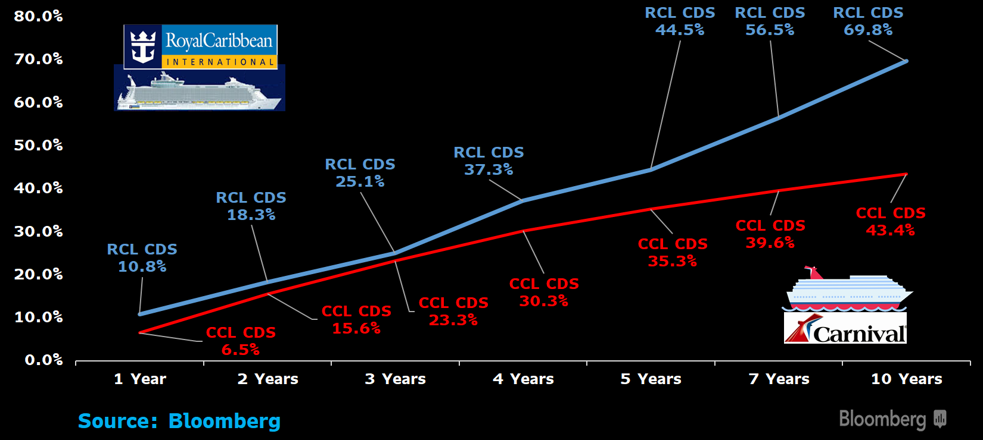
Cruise Lines: Signals From CDS Seas
October 2, 2020 January 4, 2021
Notes:
Still some concern for cruise lines as we go further out, but vaccine catalyst combined with capital raising completed in 2020 helped change investors’ attitude towards the sector.
Nevertheless we see a long trip ahead before normalcy and no clear catalyst to cause cruise debt to grind tighter
In fact, more unknowns still lurk, such as the variant strain, geopolitical policy changes and tensions among key cruise locations, minimal room for error by cruise companies

Slide 45
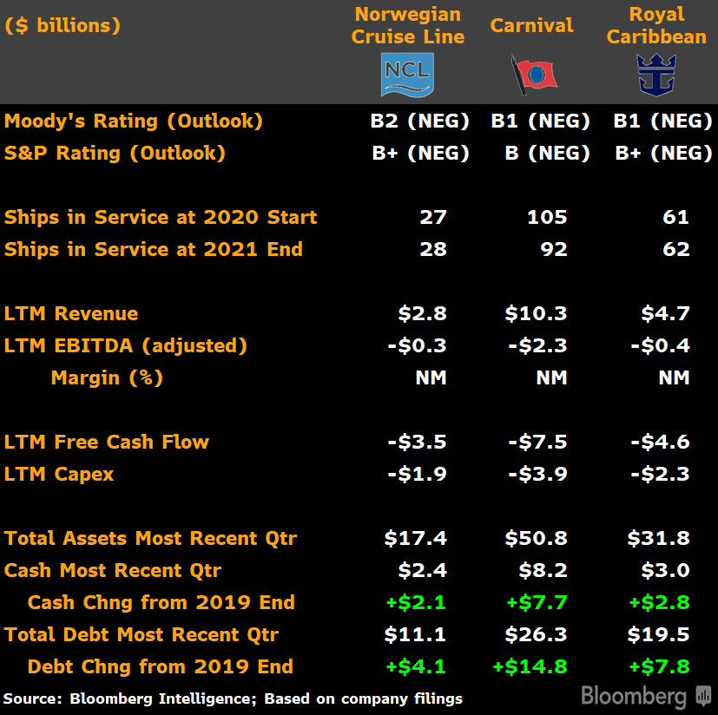
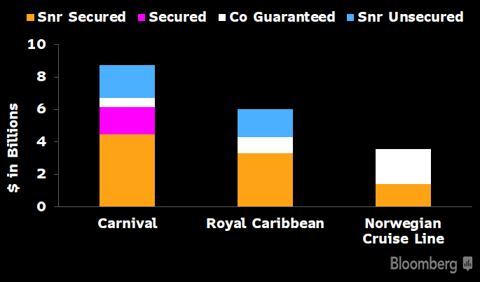
Cruise Lines: Shedding Assets to Raise Cash
Notes:
Fundamentally, better than height of pandemic in terms of liquidity, but capital structure more complicated and minimal room for error
Asset values likely less than book should a rush to sell all at once – e.g. energy E&P, rental car companies
Bigger balance sheets thanks to debt and cash
Advanced bookings not what is was in terms of cash generation – companies are pushing marketing campaigns to reduce dependency on capital markets, but longer before cruising, more likely need to discount trips and more potential for cash refunds

Slide 46
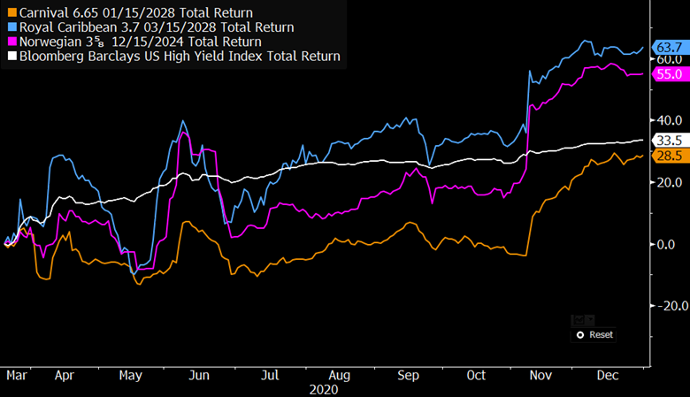
Cruise Lines: A Look at Returns vs. High Yield
Notes:
We looked at three bonds that were outstanding before the pandemic by the largest cruise lines
RCL and NCLH well outperformed, while CCL slightly underperformed
- Reasons: comparative size, capital structures, attention to credits
- May be some credit- or security-specific opportunities

Slide 47
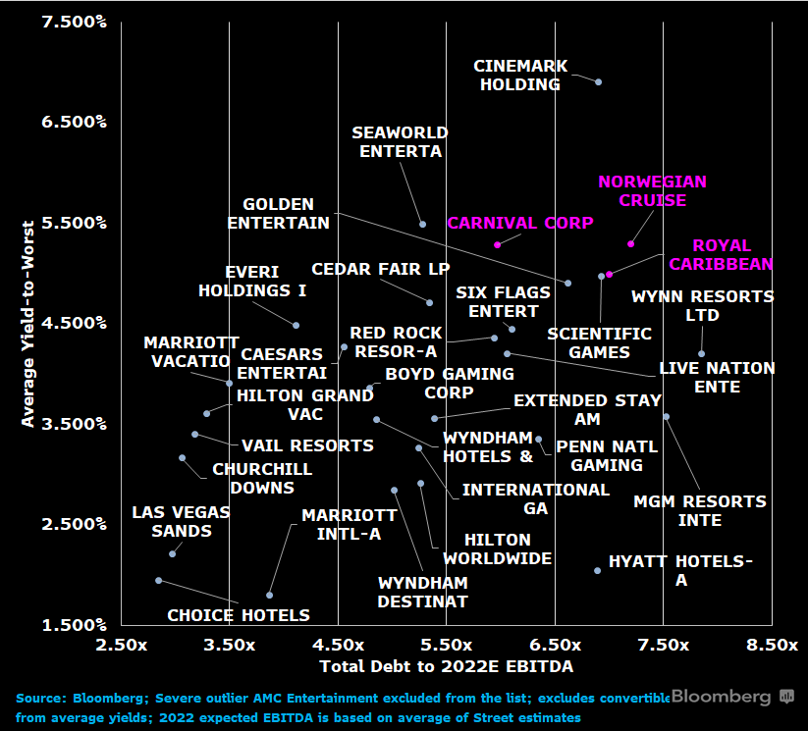
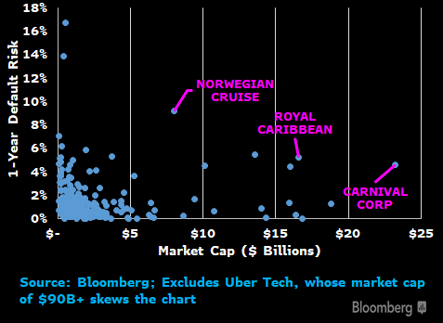
Cruise Lines: Default Risks Clash With Market Caps
Notes:
Explain chart on right then chart on left
Few other industries full-stop for operations during pandemic
Capital markets more forgiving than expected
Biggest catalyst behind us
Too many unknowns to justify current valuation
High yield in general pretty rich so net-net, we do not see benefit of buying cruise line debt

Slide 48
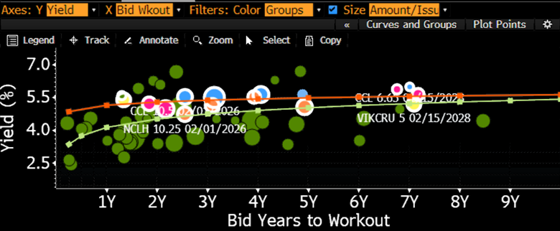
Cruise Lines: Small Extra Yield vs. Leisure Debt
Cruise Line Curve
All Leisure Curve
Notes:
Looking at Single B to Triple C rated leisure bonds
Only trading tight of companies except a few movie theater and LBO’ed resort bonds, but trading just above the all leisure line – many other leisure companies did not full-stop operations
No real argument for why to jump into cruise specifically

Slide 49

Cruise Lines: Rising Tide Lifts All Boats
Notes:
Two sides to the cruise line story:
Look at vaccine rollout, cash position, welcoming capital markets, reduced debt load in 2021 – in a good spot, esp considering where they were in spring 2020
Failed attempts to get back on the water, elevated costs and geopolitical risks, Covid spread, nearing end of covenant waivers, limited additional room for cash
Cruise industry has never experienced this full-stop on operations globally
Capital markets have been kind. Companies have enough cash to last through 2021
Vaccine changed tenor of industry – more a question of when can get back in the waters

Slide 50

Utilities, Integrated Oils, Refining & Marketing
Jaimin Patel
Bloomberg Intelligence
Senior Credit Analyst
+1-609-279-5915
jpatel214@bloomberg.net

Slide 51

FirstEnergy vs. Utility Holdco Bond Spreads
Source: Bloomberg Intelligence

Slide 52

FirstEnergy Regulated Utility Subsidiaries
Source: Bloomberg Intelligence

Slide 53


FirstEnergy Bond Spreads

Slide 54

FirstEnergy vs. IPPs Bond Spreads
Source: Bloomberg Intelligence

Slide 55

PBR vs. XOM, RSDA Bond Spreads
Source: Bloomberg Intelligence

Slide 56

LatAm vs. Canadian Oil Bond Spreads
Source: Bloomberg Intelligence

Slide 57

Petrobras vs. Ecopetrol bond Spreads
Source: Bloomberg Intelligence

Slide 58

Pemex vs. PBR Bond Spreads
Source: Bloomberg Intelligence

Slide 59

PBR, Pemex, EC vs Sovereigns Bond Spreads
Source: Bloomberg Intelligence

Slide 60

Stephen Flynn – Sr Credit Analyst, Communications

Slide 61

C-Band War Chests May Not Be Big Enough
Source: Company Presentations, Bloomberg Intelligence

Slide 62

Largest High Grade Borrowers May Get Bigger
Source: Bloomberg

Slide 63

C-Band Spectrum-Purchase Scenario Analysis
Source: Company Filings, Bloomberg Intelligence

Slide 64

AT&T Balance Sheet May Bend, Not Break
Source: Company Filings, Bloomberg Intelligence

Slide 65

Bond Spread Curves: AT&T vs. Baa2/BBB
Source: Company Filings, Bloomberg Intelligence

Slide 66

Verizon – Single A Ratings May Be Far Away
Source: Company Filings, Bloomberg Intelligence

Slide 67

Verizon Bonds Framed By Comcast, AT&T
Source: Company Filings, Bloomberg Intelligence

Slide 68

Great Time to Borrow Money
T-Mobile US’ sale on January 11 of Ba3/BB rated senior unsecured notes was upsized and priced at very low yields for non-investment grade
Source: Company Filings, Bloomberg Intelligence

Slide 69

Cable C-Band Purchase Scenarios
Source: Company Filings, Bloomberg Intelligence

Slide 70

Capital Allocation May Change With C-Band Buy
Charter Quarterly Cash Outflows for Buybacks
Source: Company Filings, Bloomberg Intelligence

Slide 71

DELL: Differentiating Risks from Rewards
Robert Schiffman – Senior Credit Analyst, Technology / Internet

Slide 72

DELL: Size and Scale Matters
Source: Company Presentation, Bloomberg Intelligence
Notes:
Not sure if I mentioned, but Danaher is a serial acquirer, and as you can see, it never stops chomping! The BUYP function tells me the company has made 135 deals in its history. Note that the size of the green bubbles indicates the size of the deals the company has made. You can see that through 2010, the bolt-on strategy for deal-making was common. But then in 2011, Danaher purchased Beckman Coulter for $7 billion, and it recognized it could manage larger deals from a management perspective. It also recognized that it didn’t need to have such low leverage and an A-tier rating, as it held for years under Larry Culp – now the Chairman of GE. So BUYP clearly shows a strategy shift towards larger deals – a cycle of leverage to delever and then buy the next asset, has begun. Something to consider later this year as the company’s balance sheet is well positioned for its next M&A bite.
As luck would have it, early at BI the team created a debt capacity model, that is a perfect complement to the MA and BUYP data. It also happens to be an Excel that any client can download and utilize for free! So we can take Danaher’s historic multiples of 15.5x Ebitda, its leverage goals of 3-4x leverage, and 2021 consensus – or your own estimates, do determine how much financial flexibility it has to stay within its BBB+ rating bands. Our Excel tool can be used for single-name work, or as shown on the right, a peer comparison - in this case, for high grade industrials.

Slide 73

DELL: An Improving Fundamental Path
Source: Company Presentation, Bloomberg Intelligence

Slide 74

DELL: BI Checklist Lit Up in Green

Slide 75


DELL: A Commitment to Deleveraging
Source: Company Presentation, Bloomberg Intelligence

Slide 76


DELL: Complex Capital Structure, Ratings Risk

Slide 77

DELL: Spreads Out on the Curve Wide to Peers

Slide 78

DELL: CDS Rally Highlights Liquidity Strength

Slide 79
Contact the BI Analysts
Joel Levington, jlevington1@bloomberg.net
Rob Schiffman, rschiffman3@bloomberg.net
Steve Flynn, sflynn58@bloomberg.net

